Slide 1
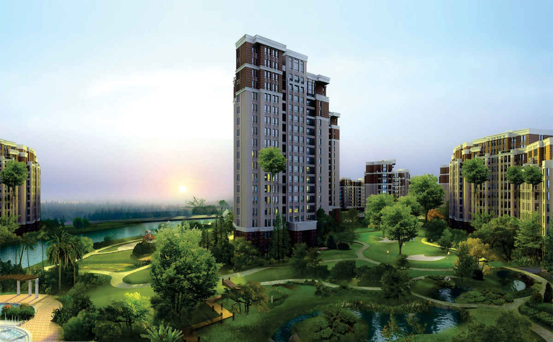


Slide 2
About the Group
JMD Group, with its presence as Jai Mega Development Pvt Ltd in Lucknow is one of the leading businesses in the Real Estate, working across Lucknow and its surrounding. With a vision to serve the Nation in fulfilling one of the most important needs of the citizens, House (Shelter). Primarily focusing in Lucknow initially involved in the sale and purchase of land in plotted form, we have established a customer relationship with over 10000 households. We look forward to serve more people through our services in fields of Real Estate.

Slide 3
Vision of the Company
To be a valuable real estate development company that benchmarks world-class real estate products and concepts, across all real estate verticals, thereby significantly contributing to building modern India and creating greater value for customers, corporate clients and investors.

Slide 4
Our Presence (Running Projects)
JMD GREEN Phase – I (Raibareli Road)
JMD GREEN Phase – II (Sultanpur Road)
JMD HOME (Memora Road)
JMD RESIDENCY Phase – I (Memora Road)
JMD RESIDENCY Phase – II (Raibareli Road)

Slide 5
JMD RESIDENCY – Phase - I
Rs. 850/-
Memora Road

Slide 6
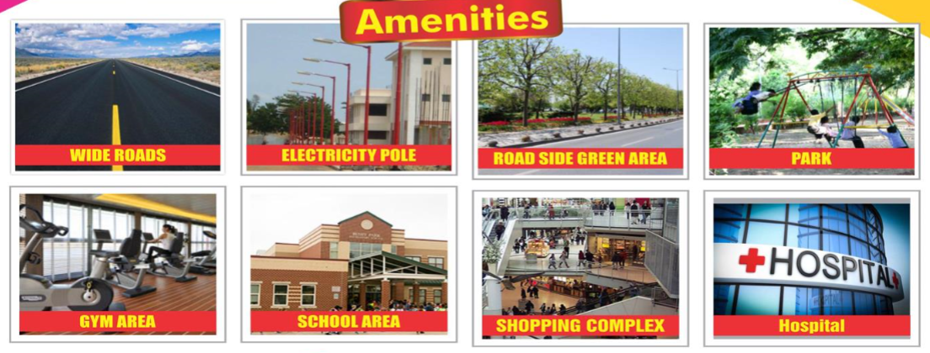
JMD RESIDENCY – Phase - I
Rs. 850/-
Memora Road
Road
Light
School
Hospital
CCTV Camera
Park
Covered Boundary
Gated Colony
Marriage Lawn

Slide 7
JMD RESIDENCY – Phase - I
Rs. 850/-
Memora Road

Slide 8
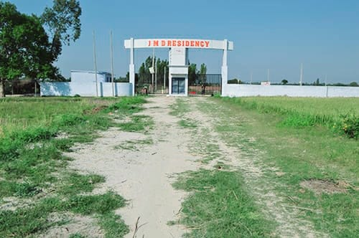
JMD Residency – Phase – I
Project Oiginal photo

Slide 9
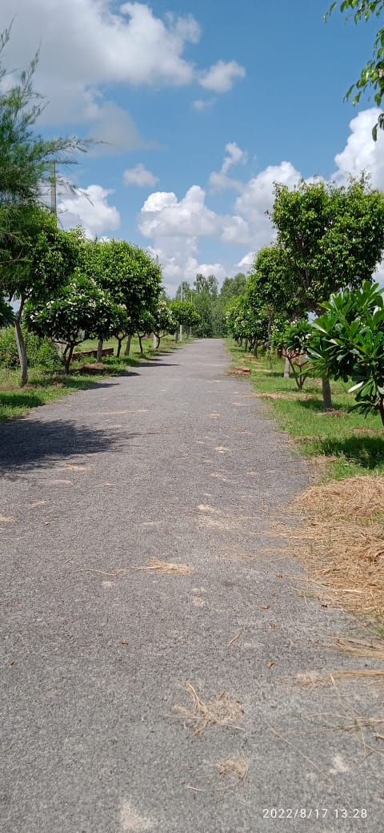
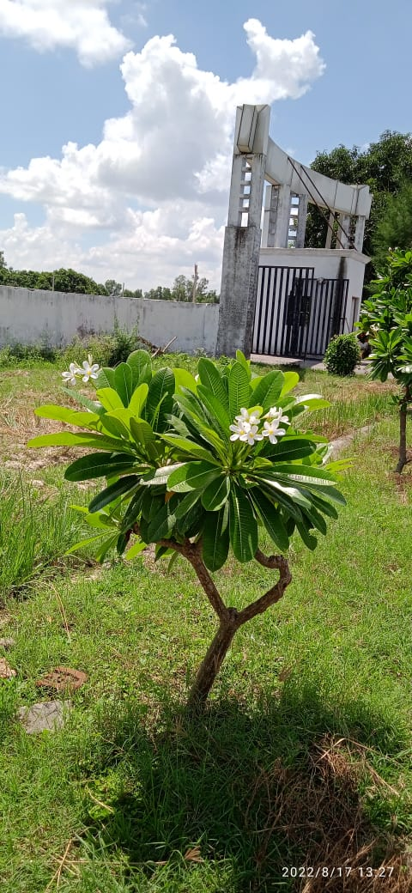
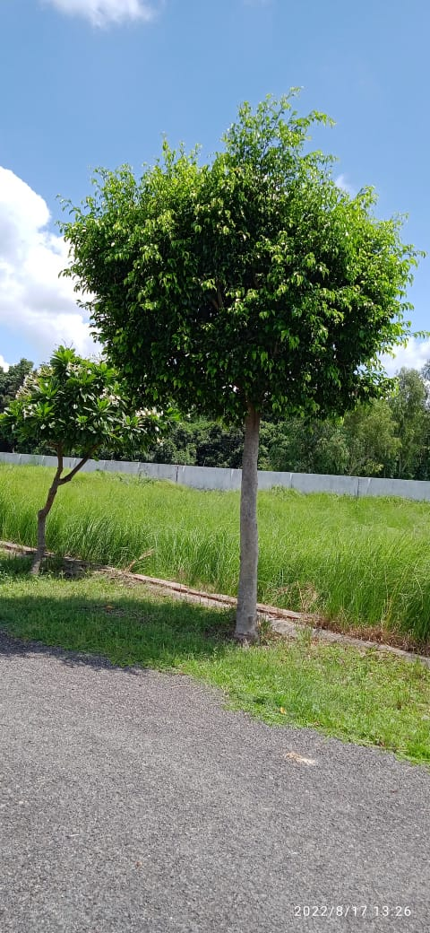
JMD Residency – Phase – I
Project Oiginal photo

Slide 10
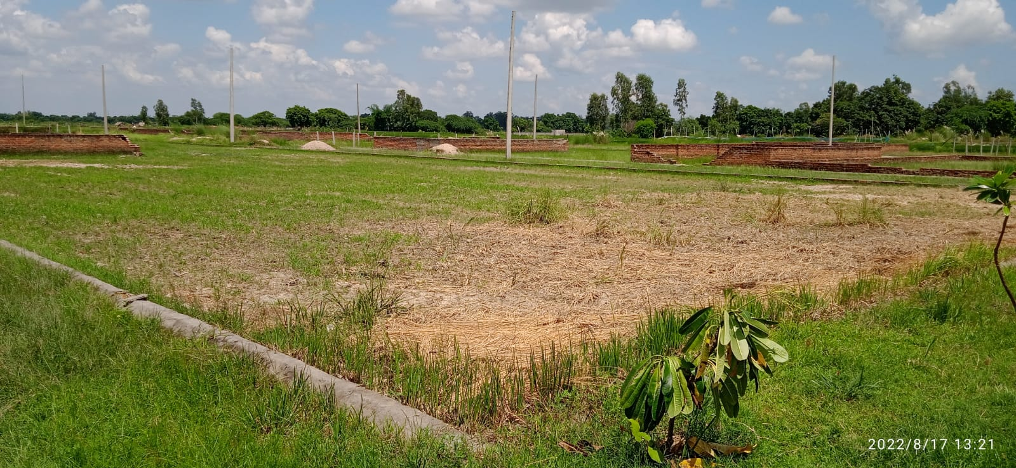
JMD Residency – Phase – I
Project Oiginal photo

Slide 11
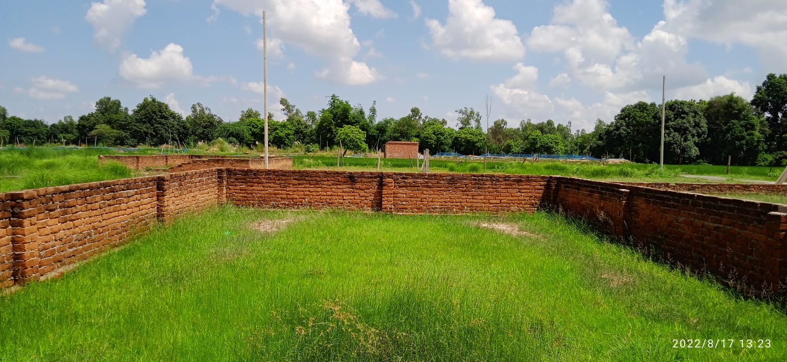
JMD Residency – Phase – I
Project Oiginal photo

Slide 12
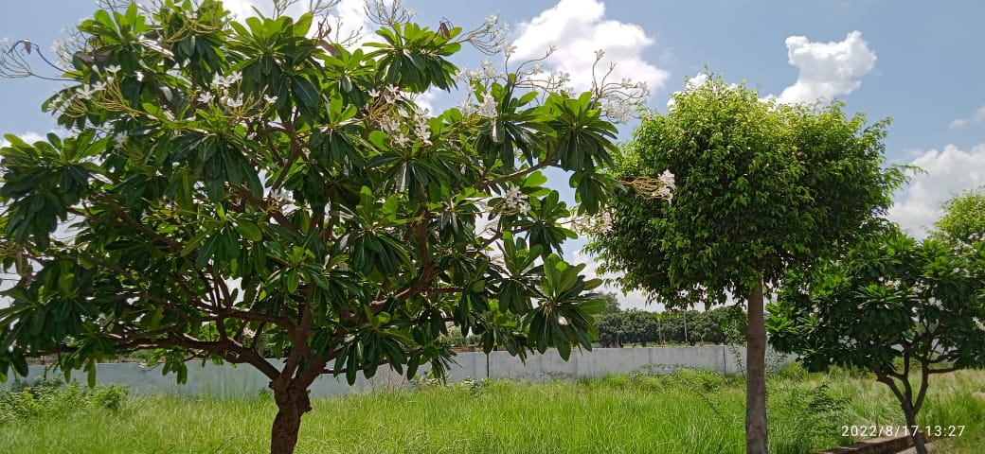
JMD Residency – Phase – I
Project Oiginal photo

Slide 13
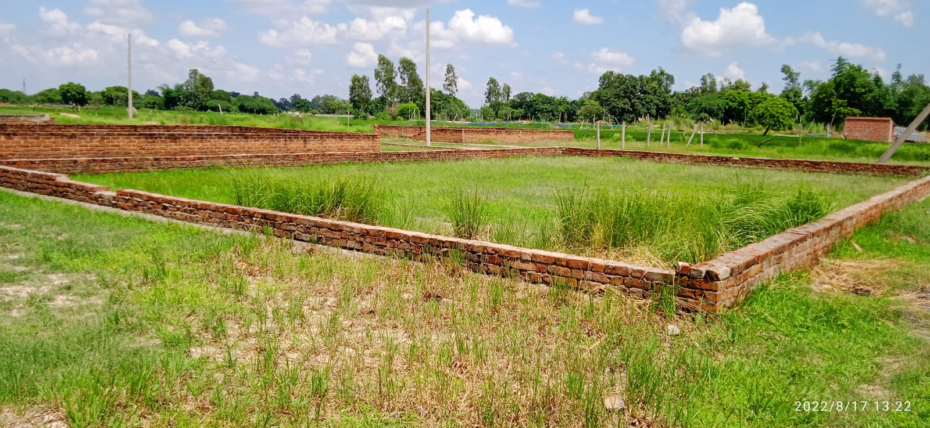
JMD Residency – Phase – I
Project Oiginal photo

Slide 14
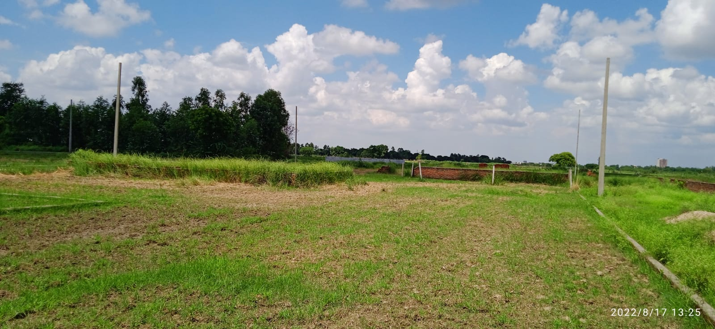
JMD Residency – Phase – I
Project Oiginal photo

Slide 15
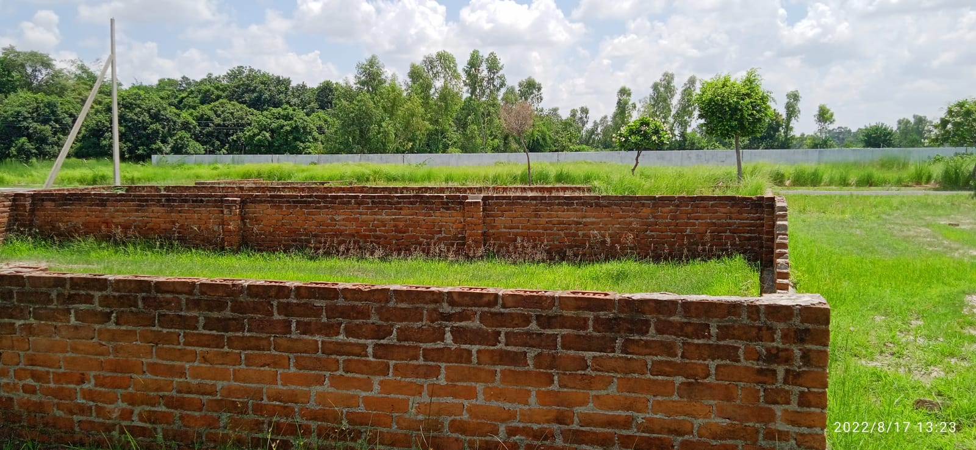
JMD Residency – Phase – I
Project Oiginal photo

Slide 16
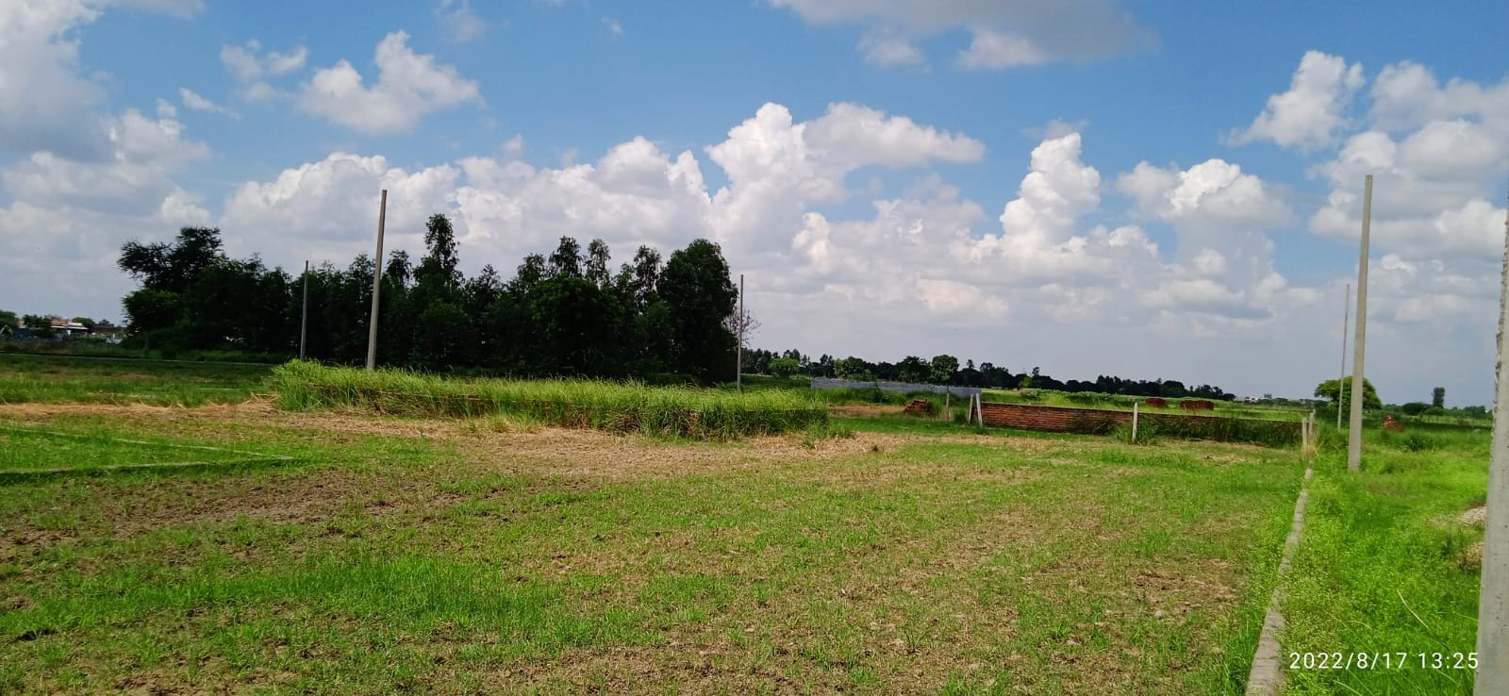
JMD Residency – Phase – I
Project Oiginal photo

Slide 17
JMD Residency – Phase – I
Project Oiginal photo

Slide 18
Why LUCKNOW ?
The City of Lucknow also know as City of Nawabs is ideally suited for investment in residential infrastructure because of the 4 C’s.
The Capital Phenomenon: Being the capital of Uttar Pradesh. Lucknow happens to be a big political centre and thus receives relatively extra favour for its all-round development, particularly related to infrastructure.
The Culture Phenomenon: The city, also known as ‘Tahzeebon ka Shahar’ is known for the calm and peaceful social environ that resides in this secular city.
Connectivity: The city is well connected to all major cities as well as small towns through good network of roads, rails and airways.
Centre of Growth: The city offers a wide range of earning and spending opportunities, in the form of jobs, services and also through world class quality education faciliites in all government as well as private institutions.

Slide 19
Master Plan - 2031
Lucknow Development Authority (LDA) has announced to develop new city master plan taking into consideration facilities which the state capital would require till 2031. The current plant highlights the city planning till 2021. The new plan will cover Housing, Transportation Facility, Road Connectivity, Green Cover, Infrastructure, etc.
The Authority also decided to include the city’s extended area and construction of an Outer Ring Road of about 150 meter wide surrounding the city, under the master plan 2031. In the Master Plan, 176 NEW VILLAGES have come under the jurisdiction of development authority. After the inclusive of these village, Master Plan 2031 has 65,387.28 HECTARE LAND under its jurisdiction as against 43,206.03 hectare in the plan for 2021.

Slide 20
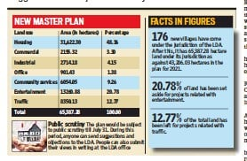
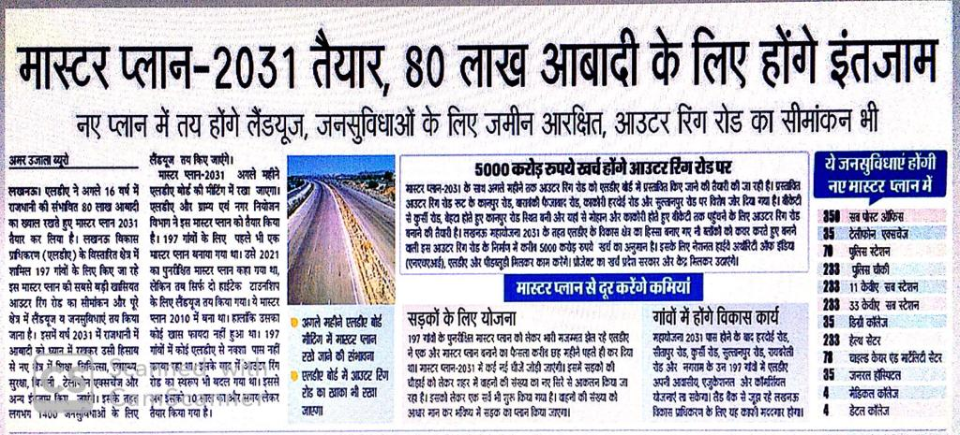
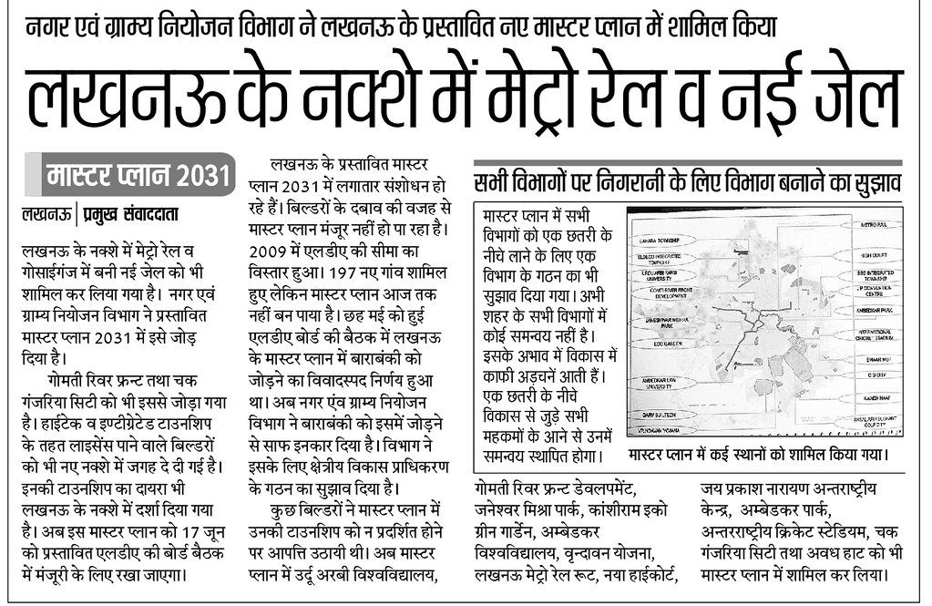
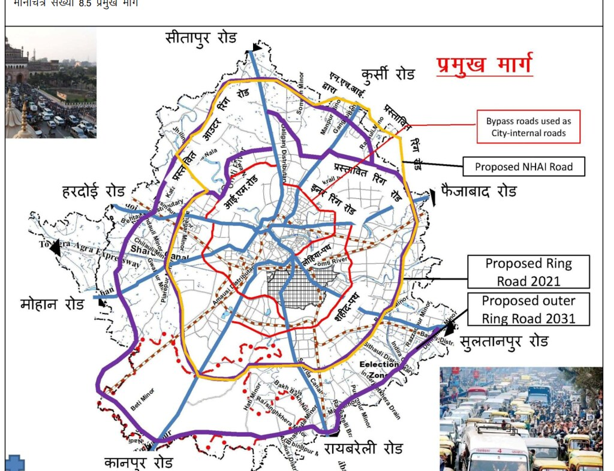
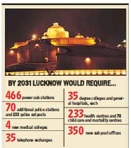
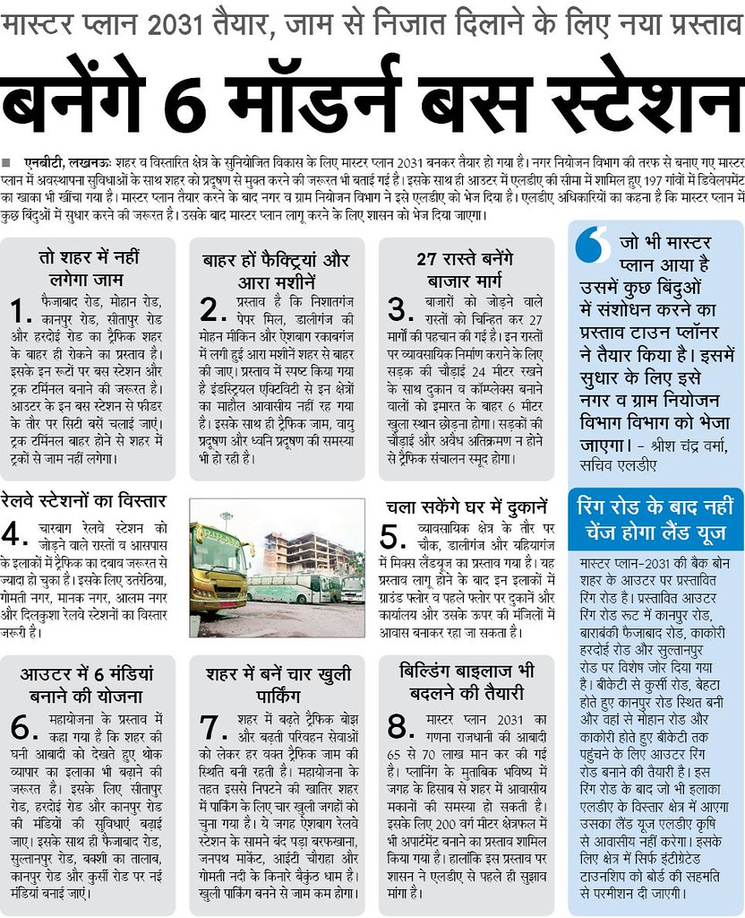
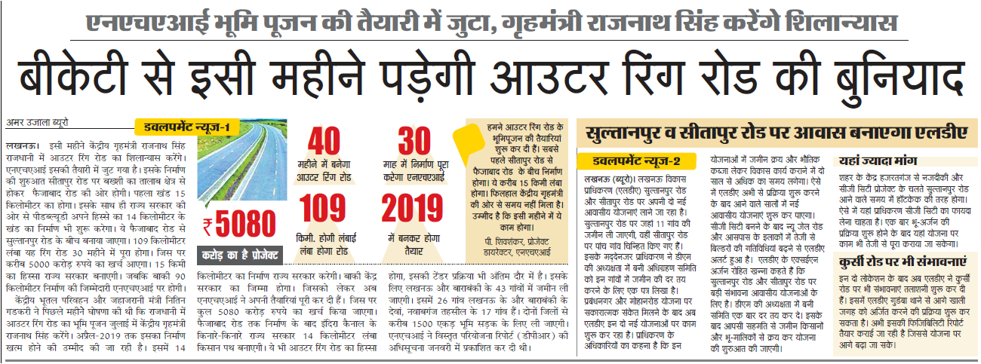
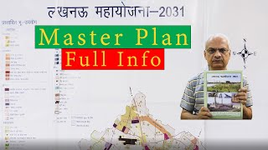

Slide 21
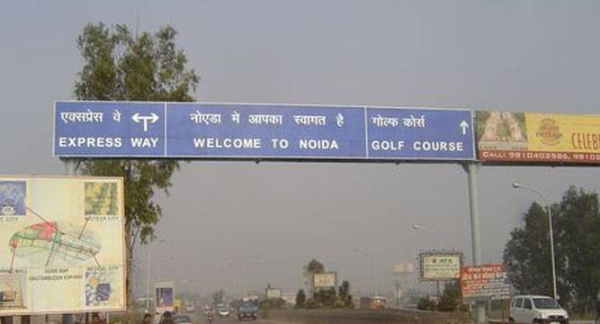
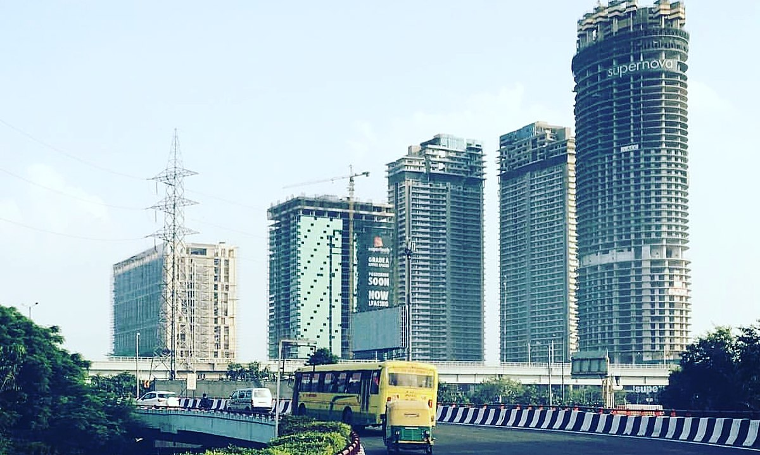
OLD NOIDA
NEW NOIDA

Slide 22
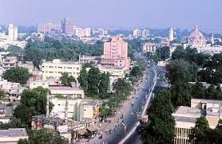
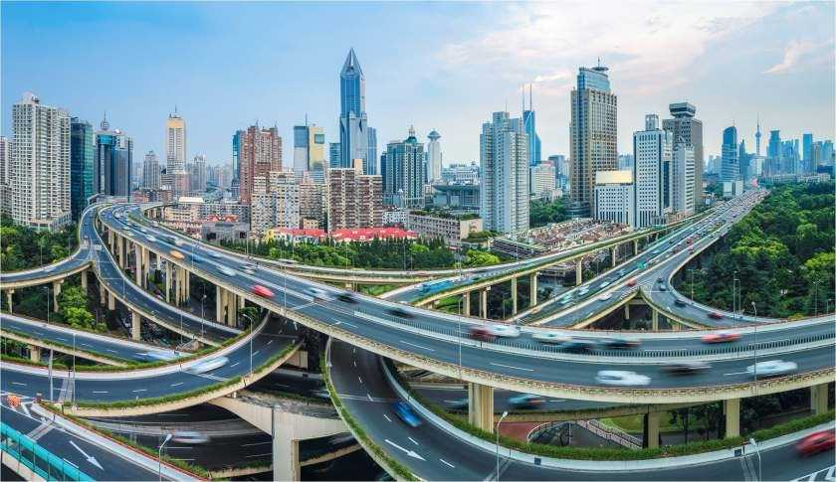
CURRENT LUCKNOW
FUTURE LUCKNOW

Slide 23
NEW LUCKNOW SCR

Slide 24
4 Basic Steps to Grow Business
LIST : Identify prospects and prepare a list of all the right customers for your business. Understanding Customer and their behavior is very important to keep up with your industry and stay ahead of competitors.
APPROACH : Connect with your prospects and schedule a time to explain them who you are and what your company is providing. Highlights the key factors of your product and its benefits.
FLOWUP : Call, Mail or personally visit to follow-up. A personalized follow-up always increase a chance of success. Resolve all queries of your customers.
CLOSE : Once you make a proper follow up and resolve all the queries of the customer its time to close the deal.

Slide 25


