Slide 1

WELCOME TO JMD GROUP
COMPANY ESTABLISHED IN 25th JAN 2012
Mr. BRIJESH KUMAR SINGH (Managing Director)

Slide 2
About the Group
JMD Group, with its presence as Jai Mega Development Pvt Ltd in Lucknow is one of the leading businesses in the Real Estate, working across Lucknow and its surrounding. With a vision to serve the Nation in fulfilling one of the most important needs of the citizens, House (Shelter). Primarily focusing in Lucknow initially involved in the sale and purchase of land in plotted form, we have established a customer relationship with over 10000 households. We look forward to serve more people through our services in fields of Real Estate.

Slide 3
Vision of the Company
To be a valuable real estate development company that benchmarks world-class real estate products and concepts, across all real estate verticals, thereby significantly contributing to building modern India and creating greater value for customers, corporate clients and investors.

Slide 4
1st PROJECT
JMD GREEN PHASE – I
Lucknow Raebareli Road
RESIDENTIAL PLOT Rs.599/- Sq.Ft
COMMERCIAL PLOT Rs.899/- Sq.Ft
EMI on 25% (Agreement)
PLC Park Facing Plot 5%
PLC Corner Plot 10%

Slide 5
JMD GREEN PHASE – I
FARMHOUSE
LAND Rs. 599/- Sq.Ft
CONSTRUCTION Rs. 1250/- Sq.Ft
2nd PROJECT

Slide 6
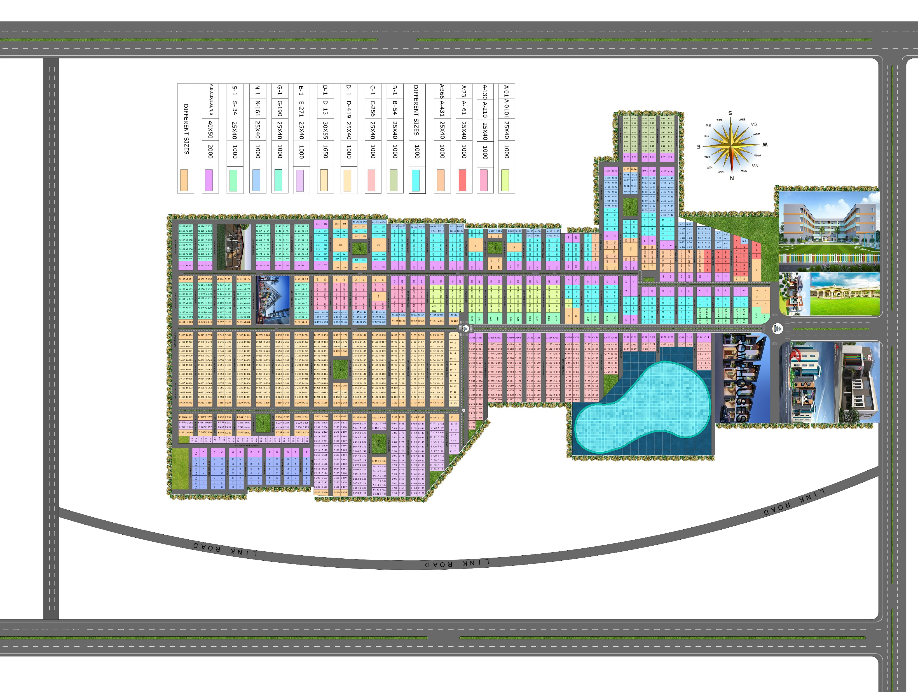
JMD GREEN PHASE – I
Lucknow Raebareli Road
LAY OUT

Slide 7
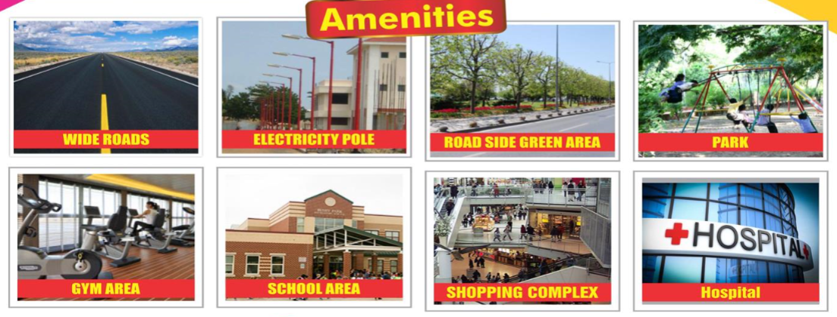
JMD GREEN PHASE – I
Lucknow Raebareli Road
Road
Light
School
Hospital
CCTV Camera
Park
Covered Boundary
Gated Colony
Marriage Lawn
Mini Stadium

Slide 8
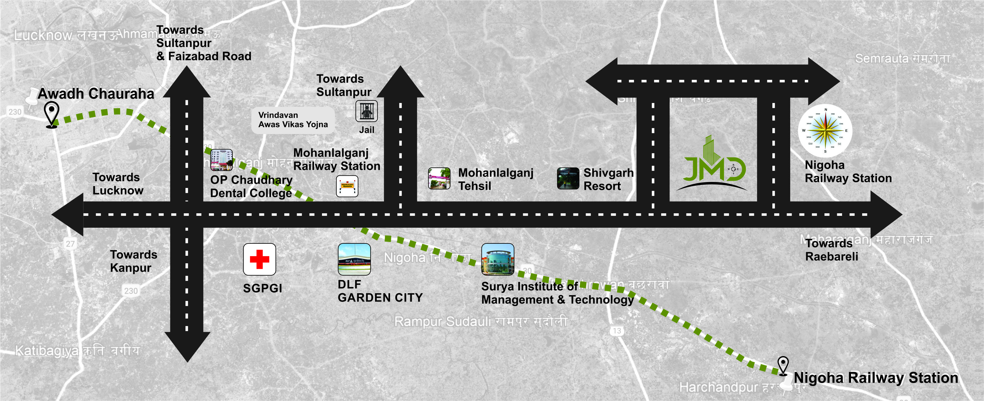
JMD GREEN PHASE – I
Lucknow Raebareli Road
KEY PLAN

Slide 9
JMD GREEN PHASE – I
Lucknow Raebareli Road
JMD GREEN PHASE – I
PROJECT IMAGES

Slide 10
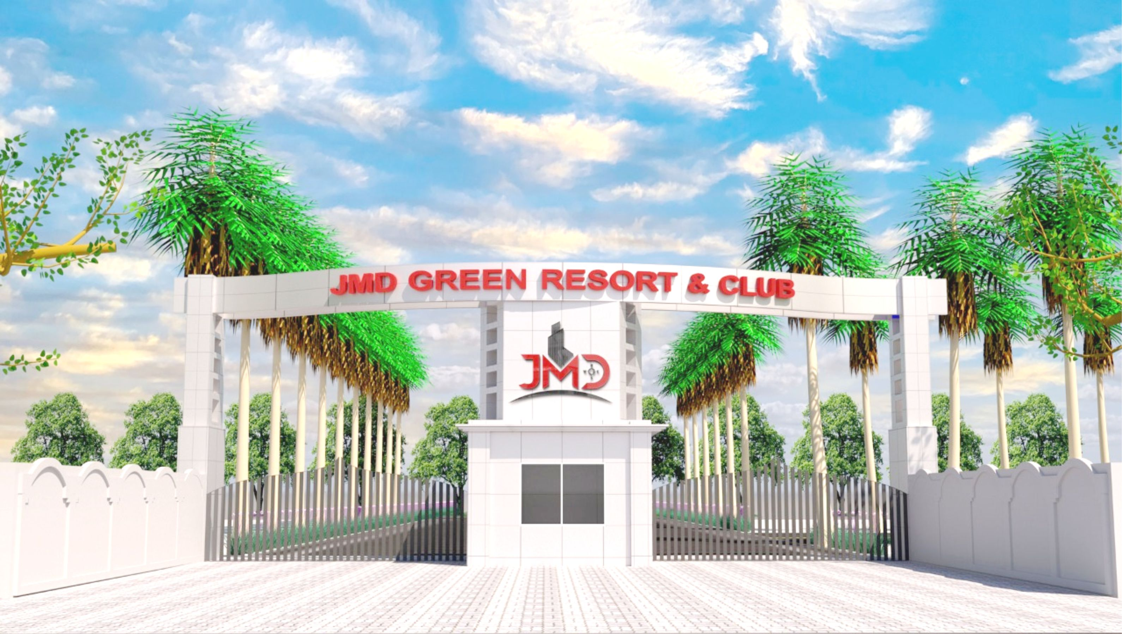
JMD GREEN PHASE – I
Lucknow Raebareli Road
GATE

Slide 11
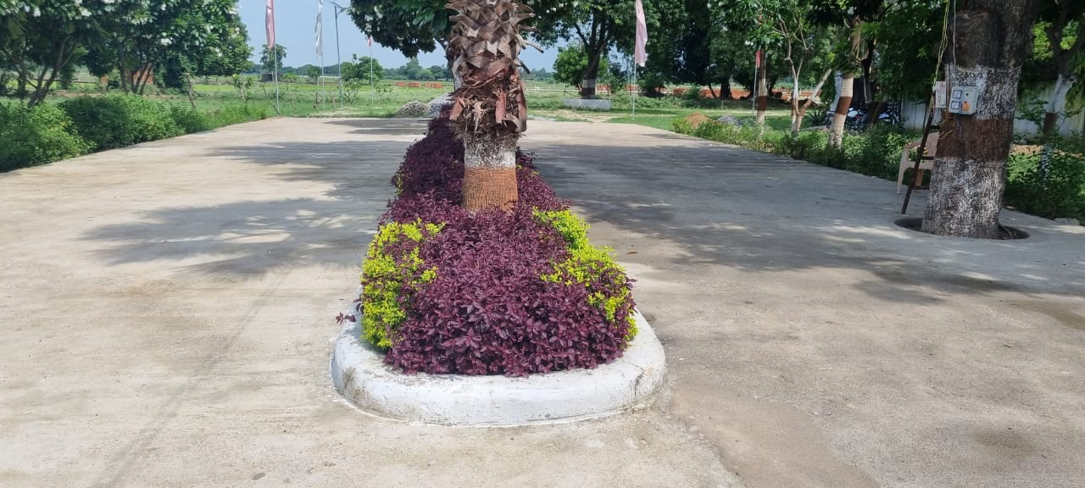
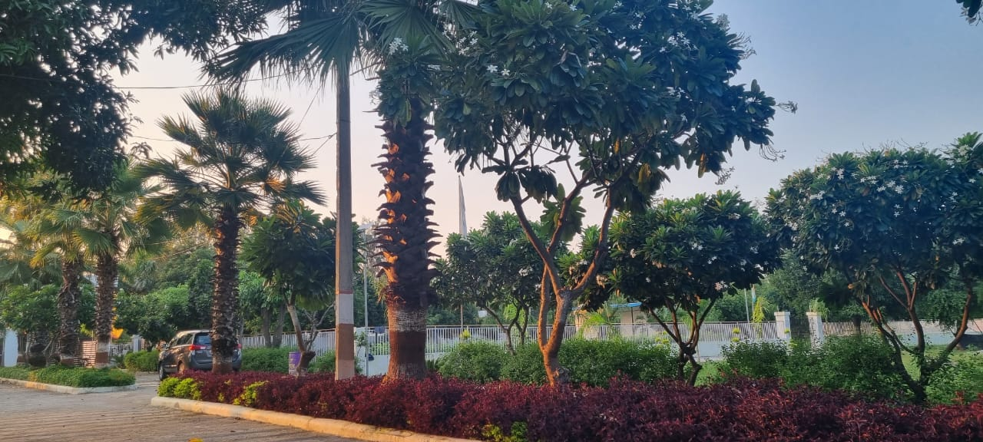
JMD GREEN PHASE – I
Lucknow Raebareli Road
DEVIDER ROAD

Slide 12
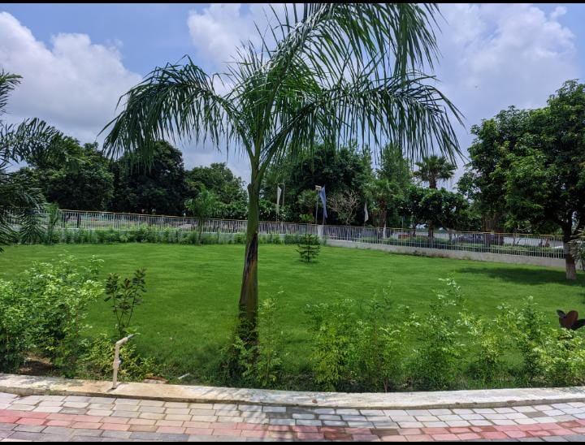
JMD GREEN PHASE – I
Lucknow Raebareli Road
PARK

Slide 13
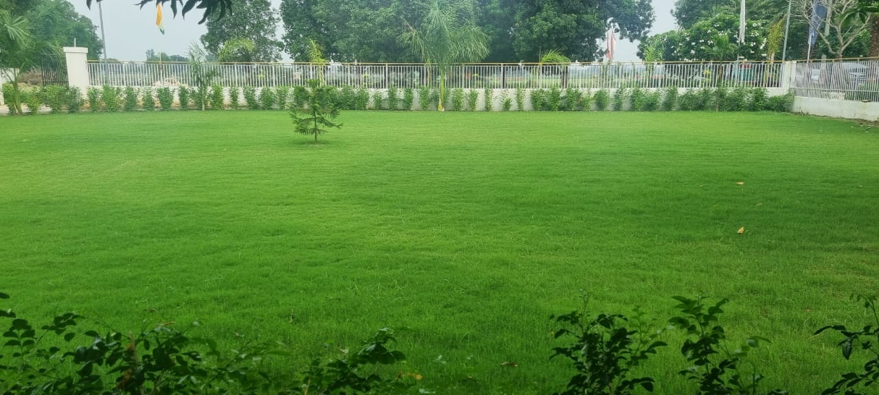
JMD GREEN PHASE – I
Lucknow Raebareli Road
PARK

Slide 14
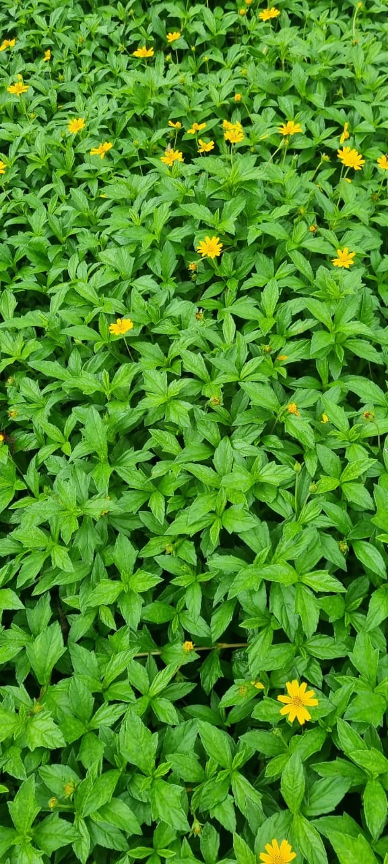
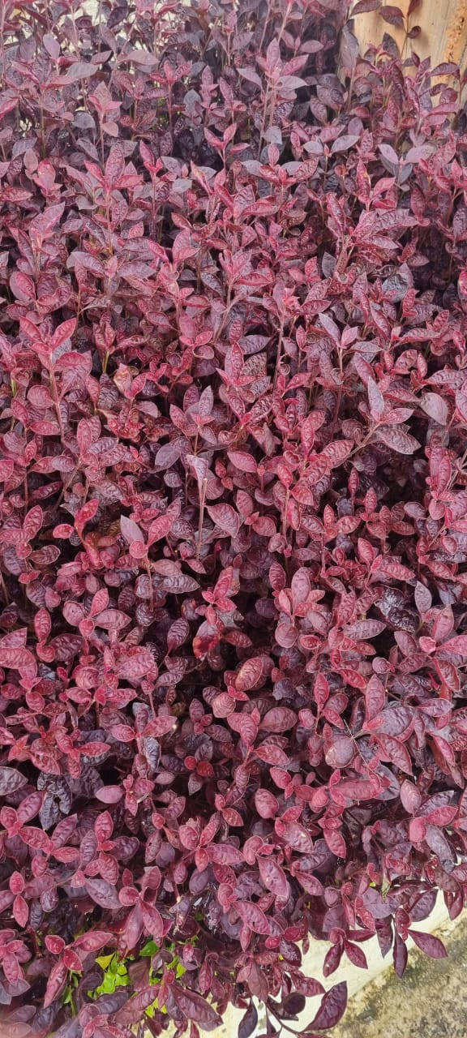
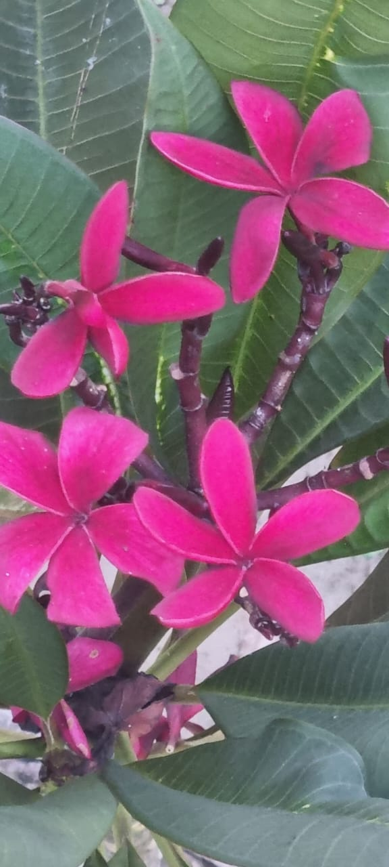
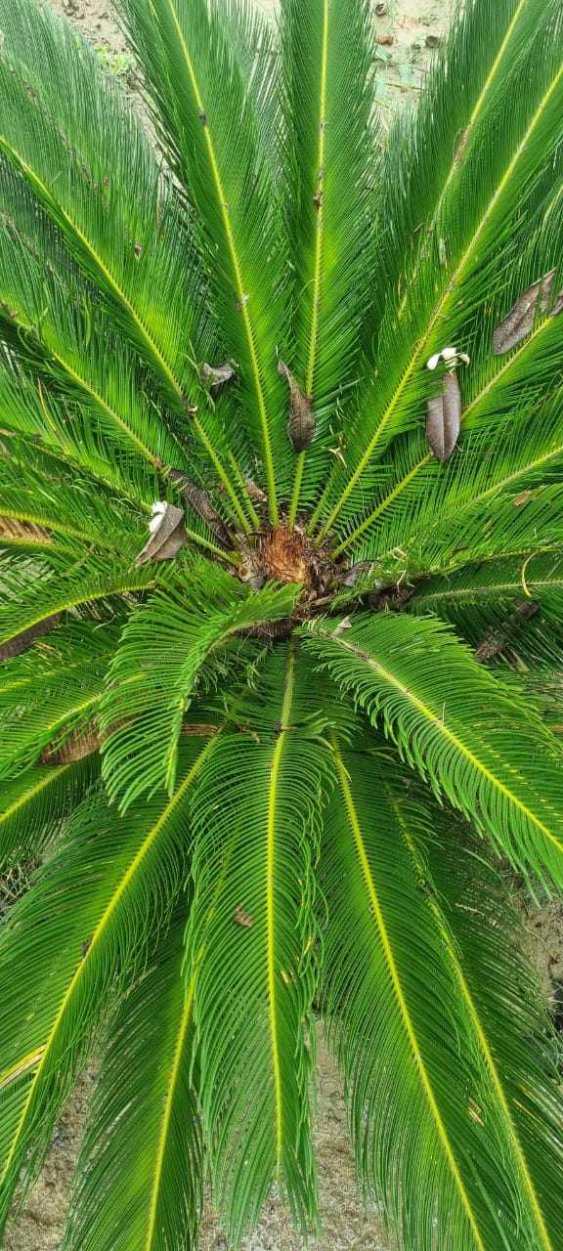
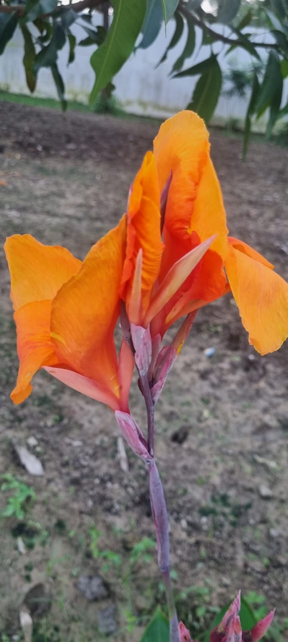
JMD GREEN PHASE – I
Lucknow Raebareli Road
PLANTS & FLOWERS

Slide 15
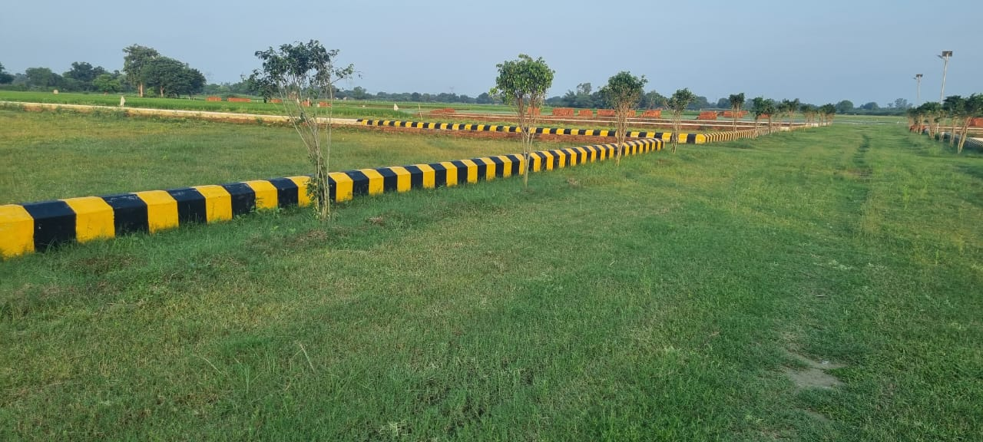
JMD GREEN PHASE – I
Lucknow Raebareli Road
PLOTS

Slide 16
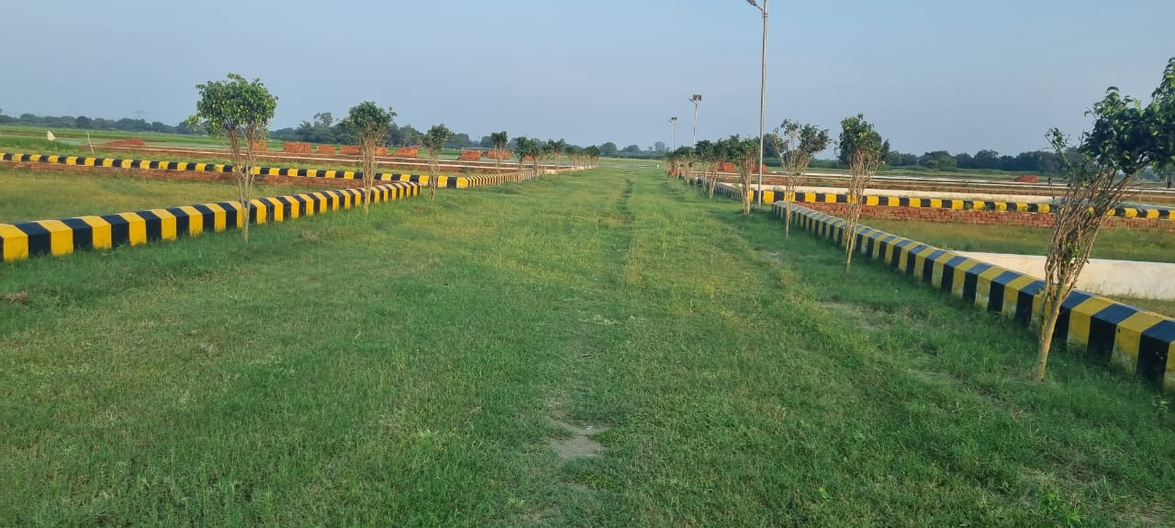
JMD GREEN PHASE – I
Lucknow Raebareli Road
PLOTS

Slide 17
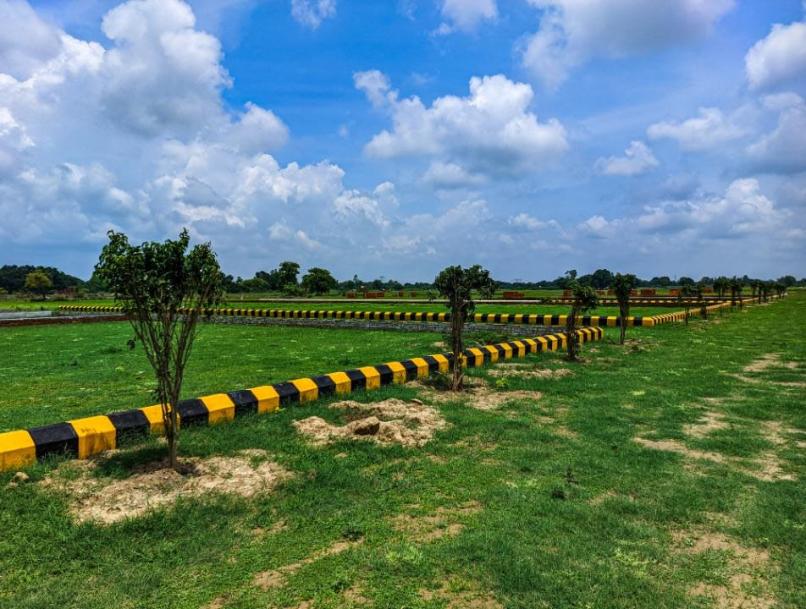
JMD GREEN PHASE – I
Lucknow Raebareli Road
PLOTS

Slide 18
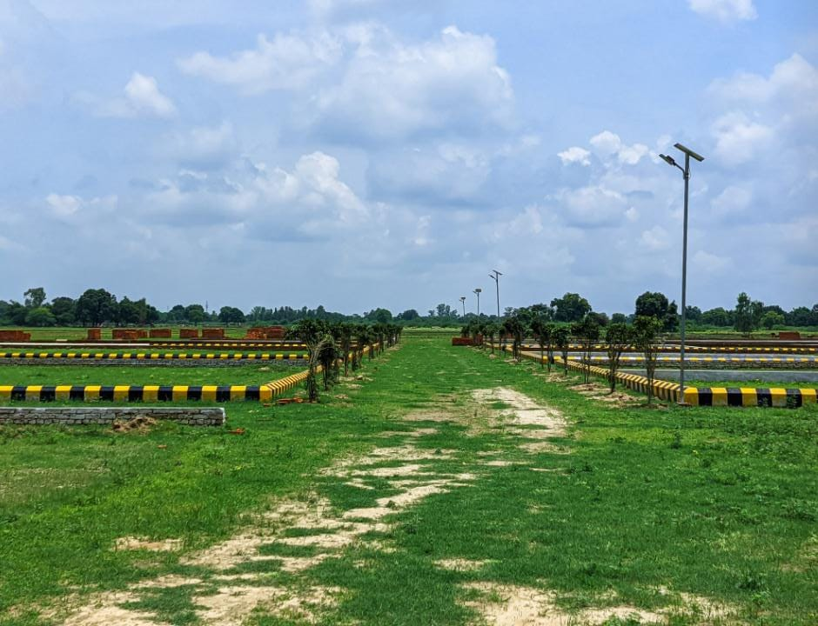
JMD GREEN PHASE – I
Lucknow Raebareli Road
PLOTS

Slide 19
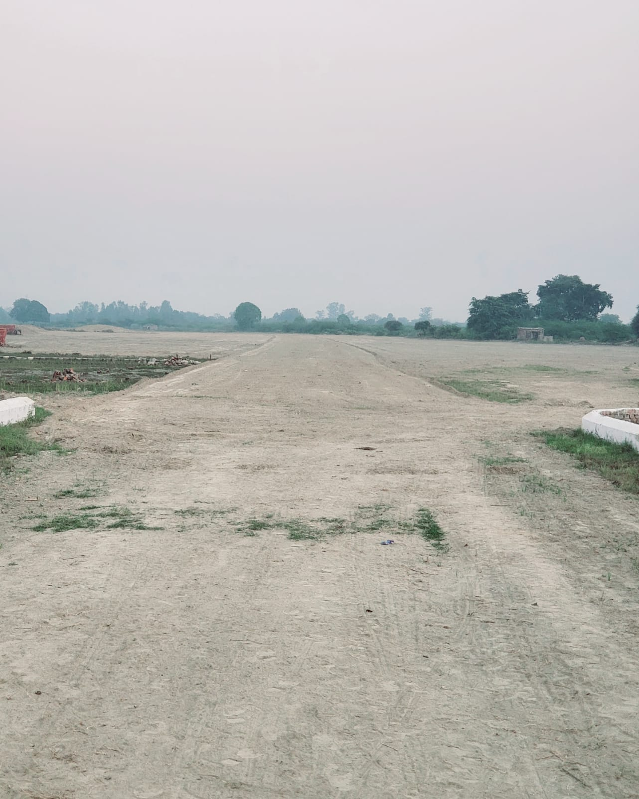
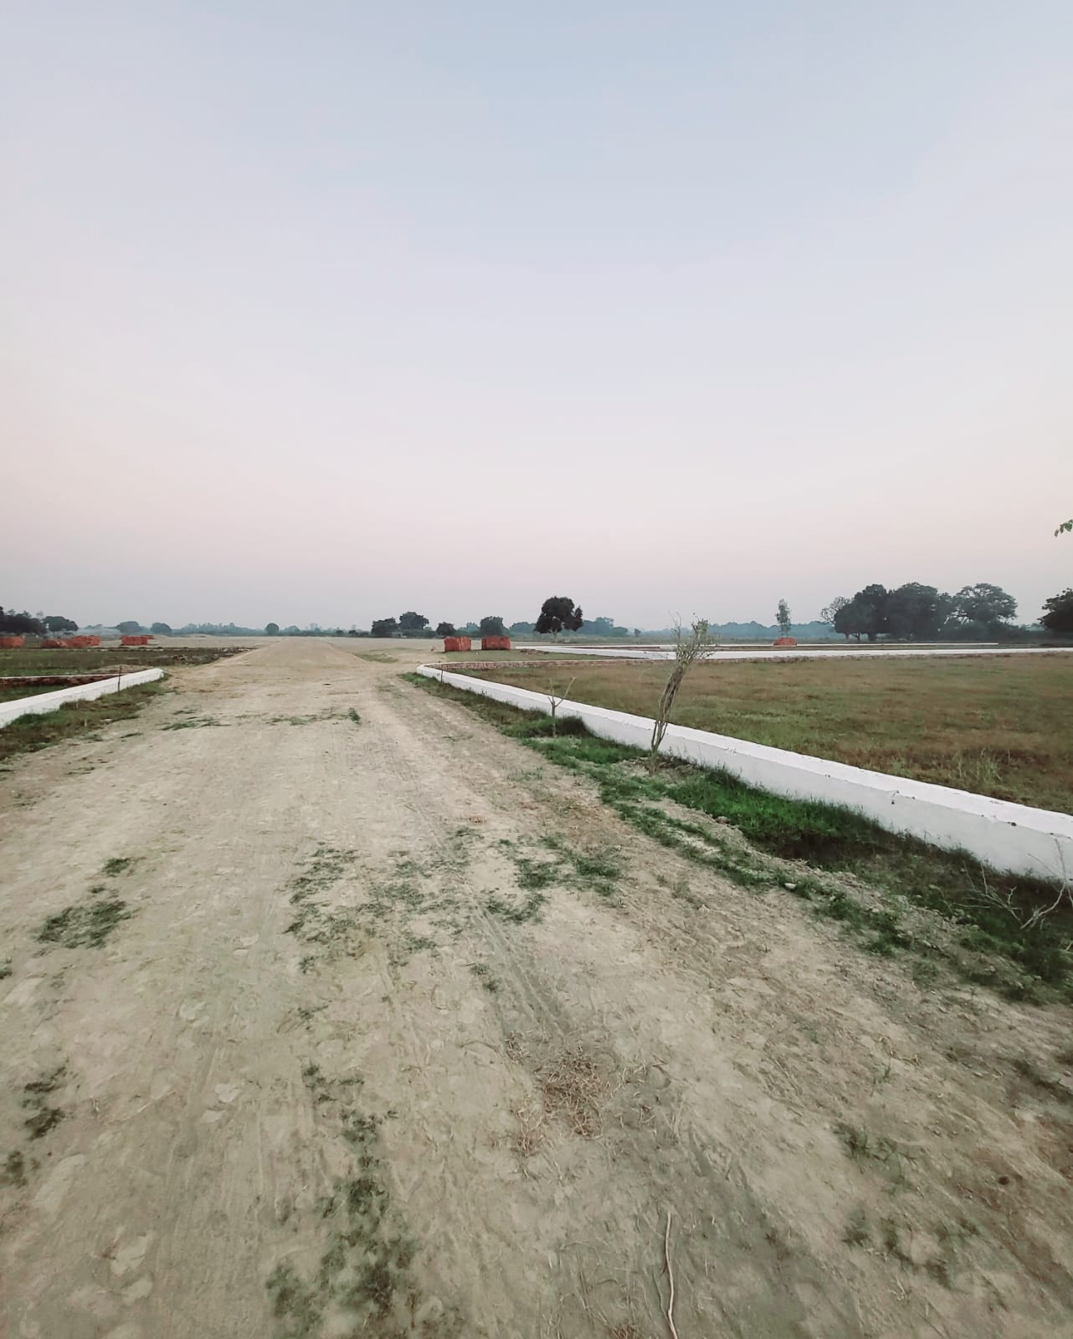
JMD GREEN PHASE – I
Lucknow Raebareli Road
PLOTS

Slide 20
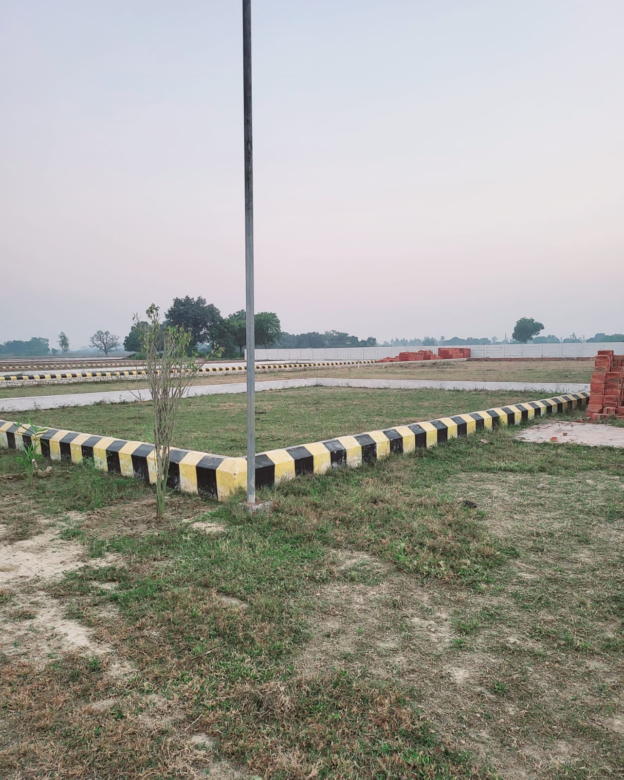
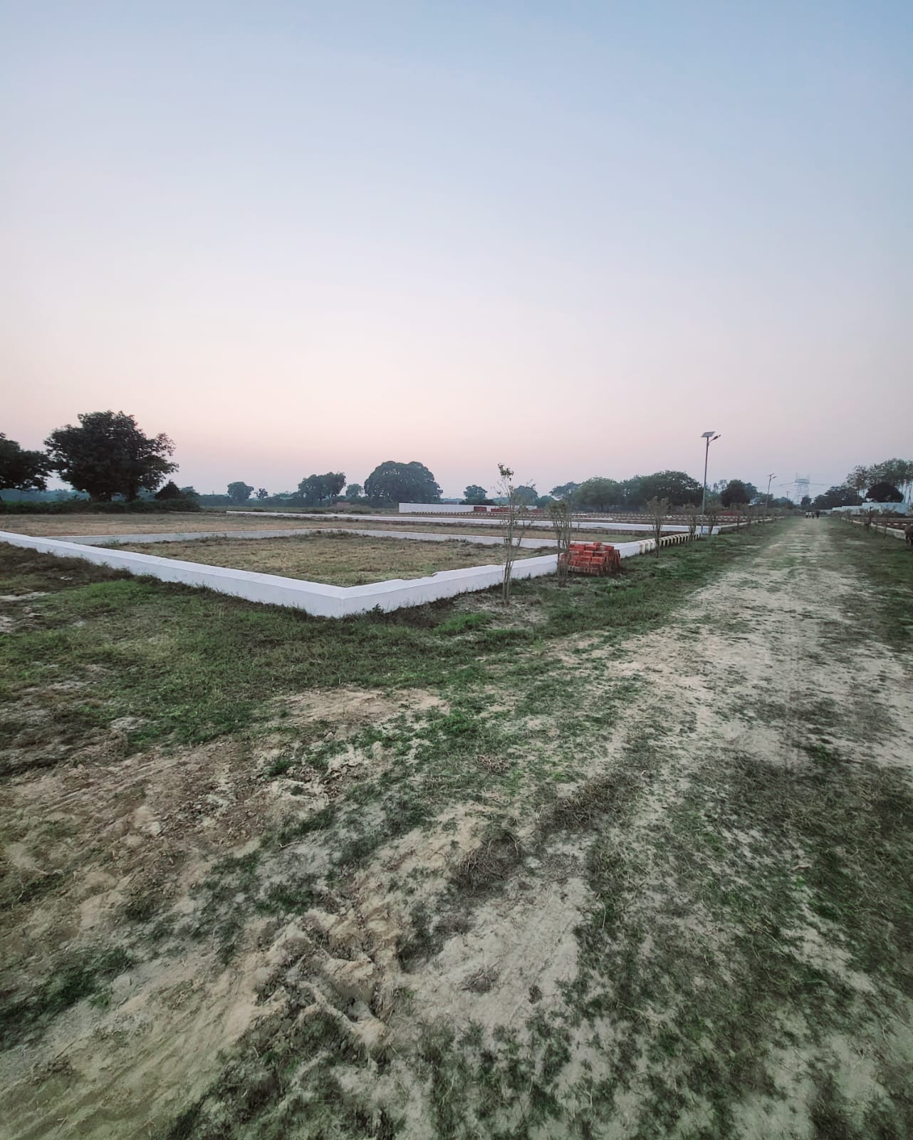
JMD GREEN PHASE – I
Lucknow Raebareli Road
PLOTS

Slide 21
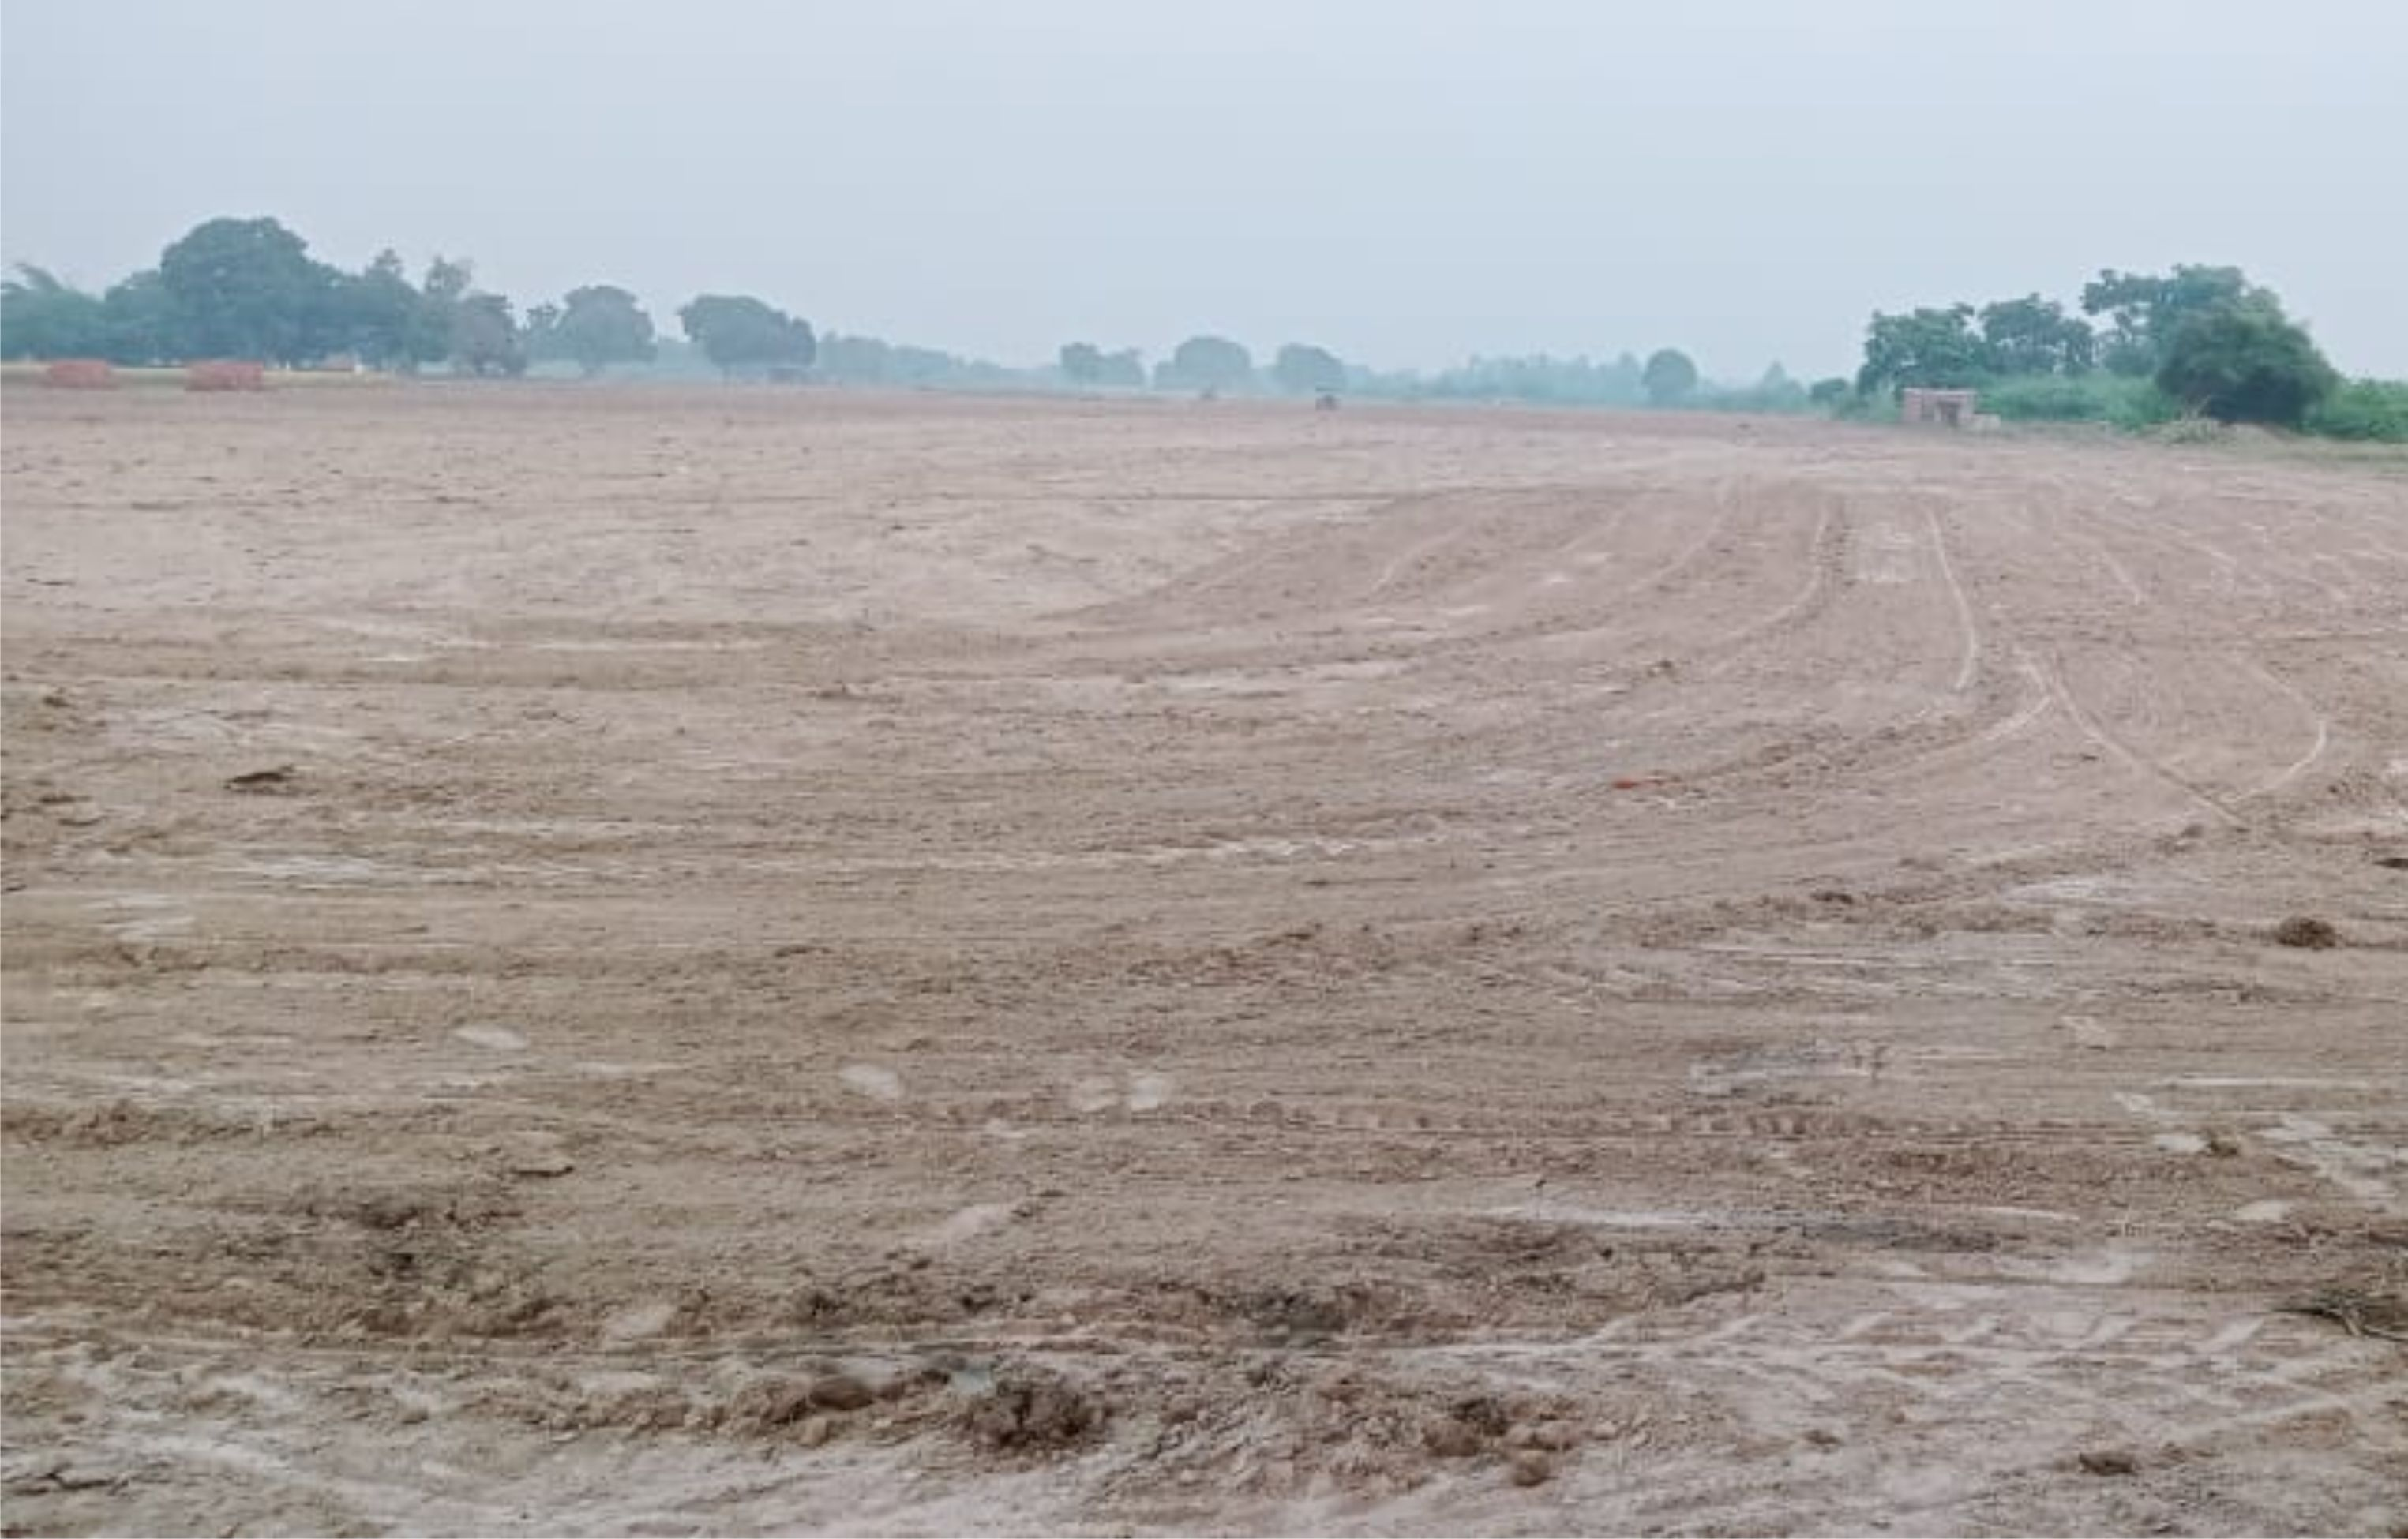
JMD GREEN PHASE – I
Lucknow Raebareli Road
PLOTS

Slide 22
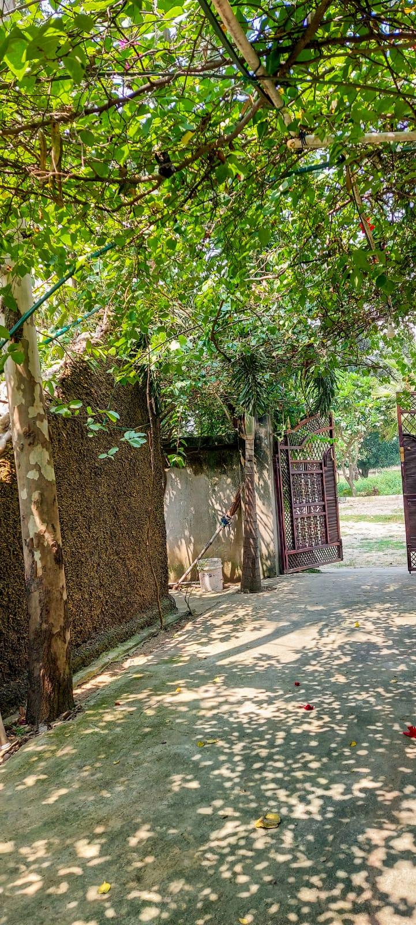
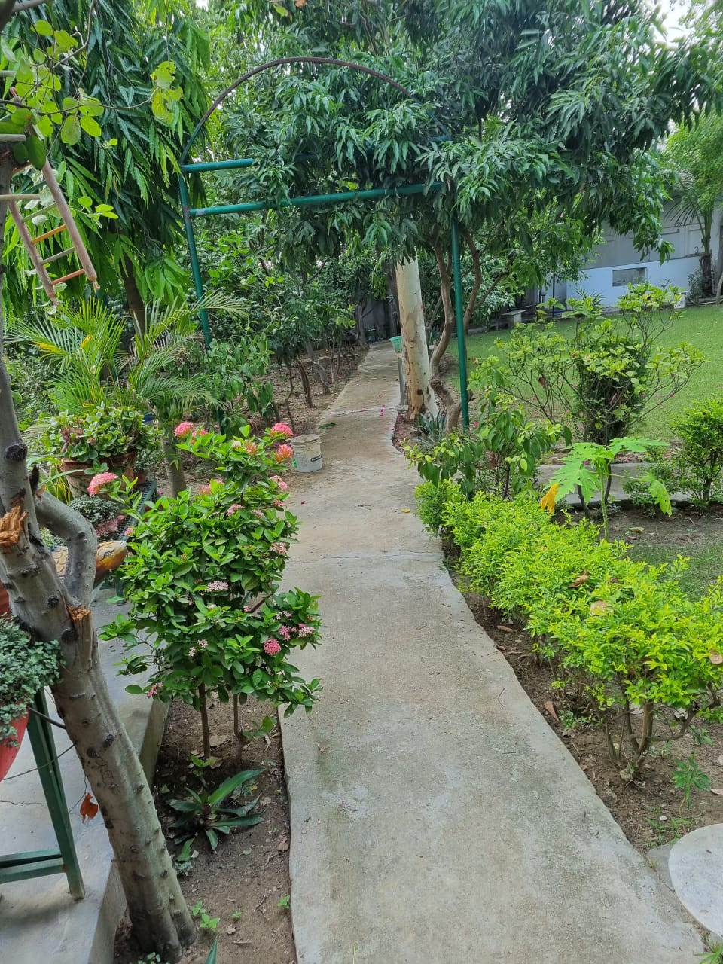
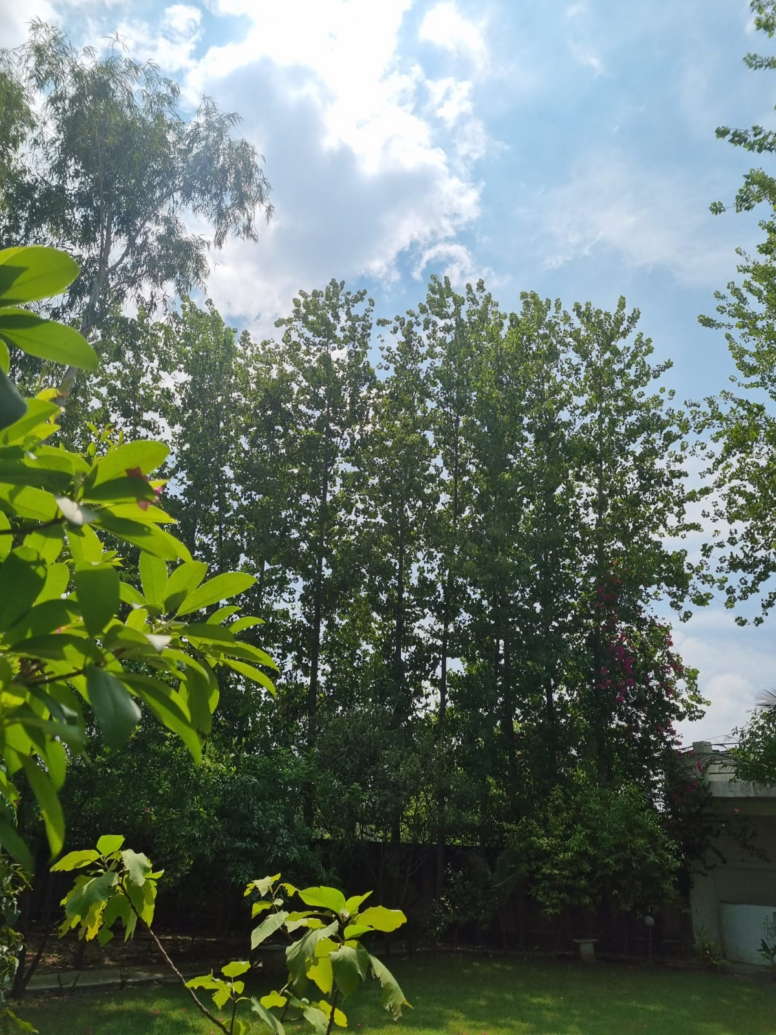
JMD GREEN PHASE – I
Lucknow Raebareli Road
FARM HOUSE

Slide 23
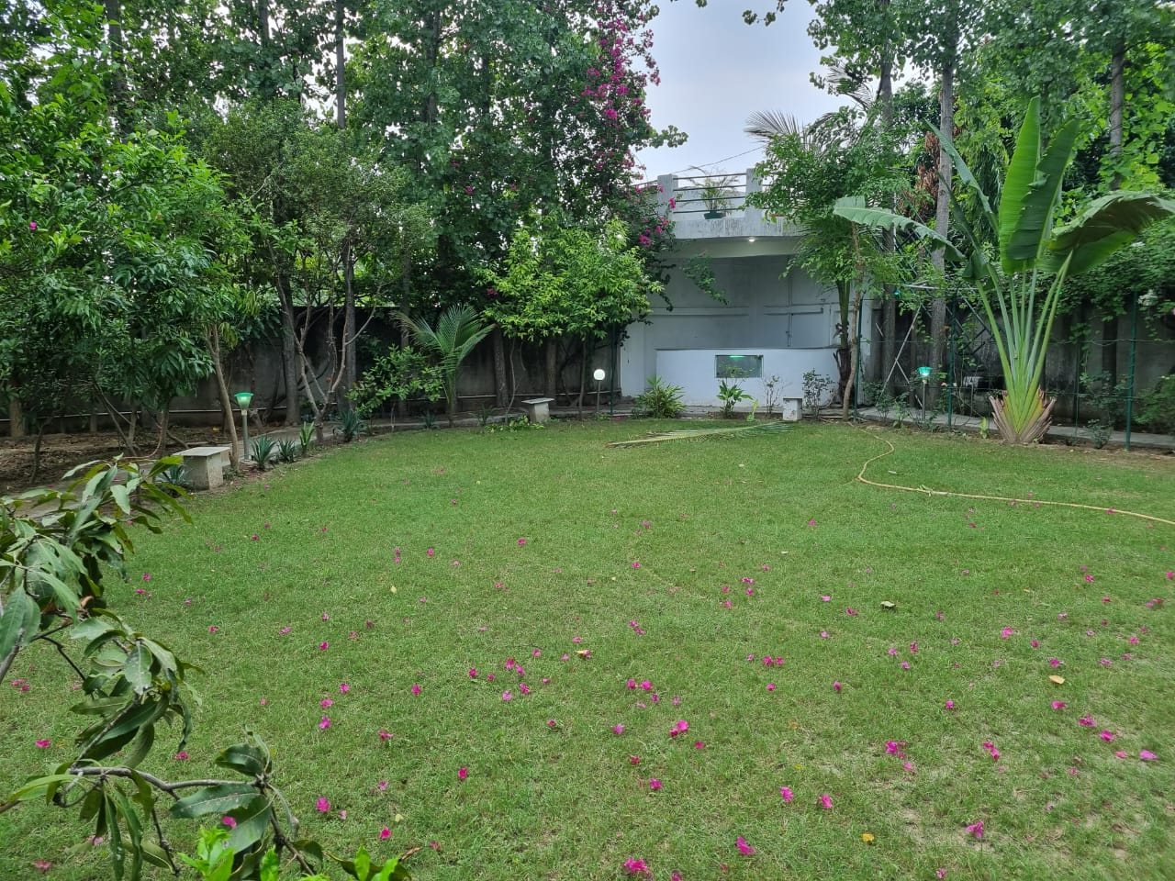
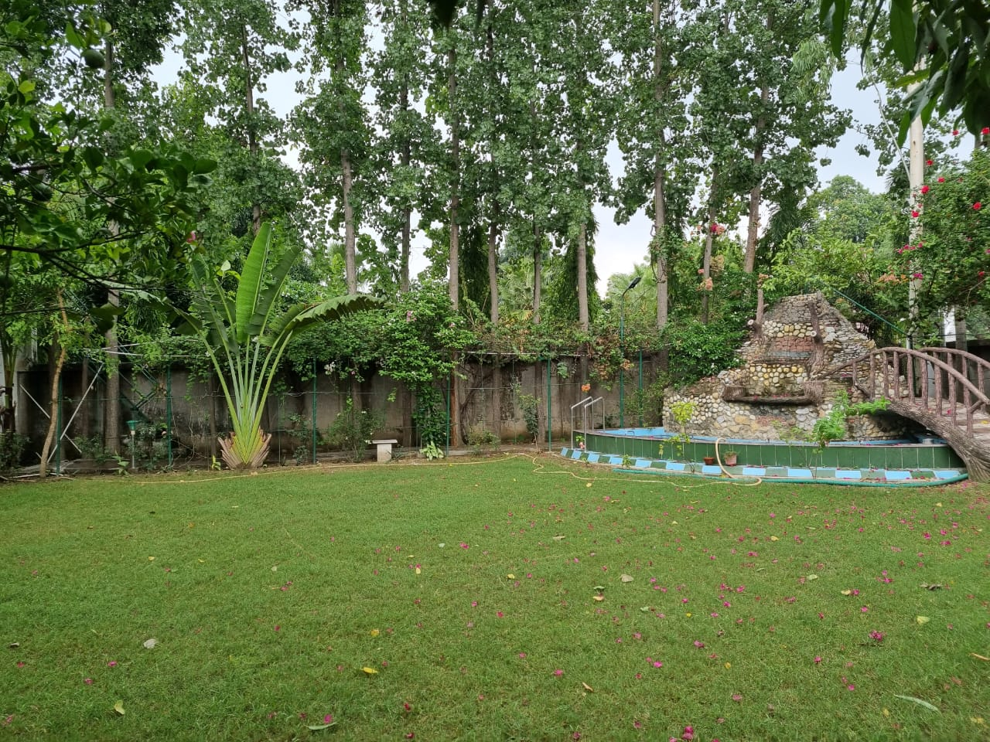
JMD GREEN PHASE – I
Lucknow Raebareli Road
FARM HOUSE

Slide 24
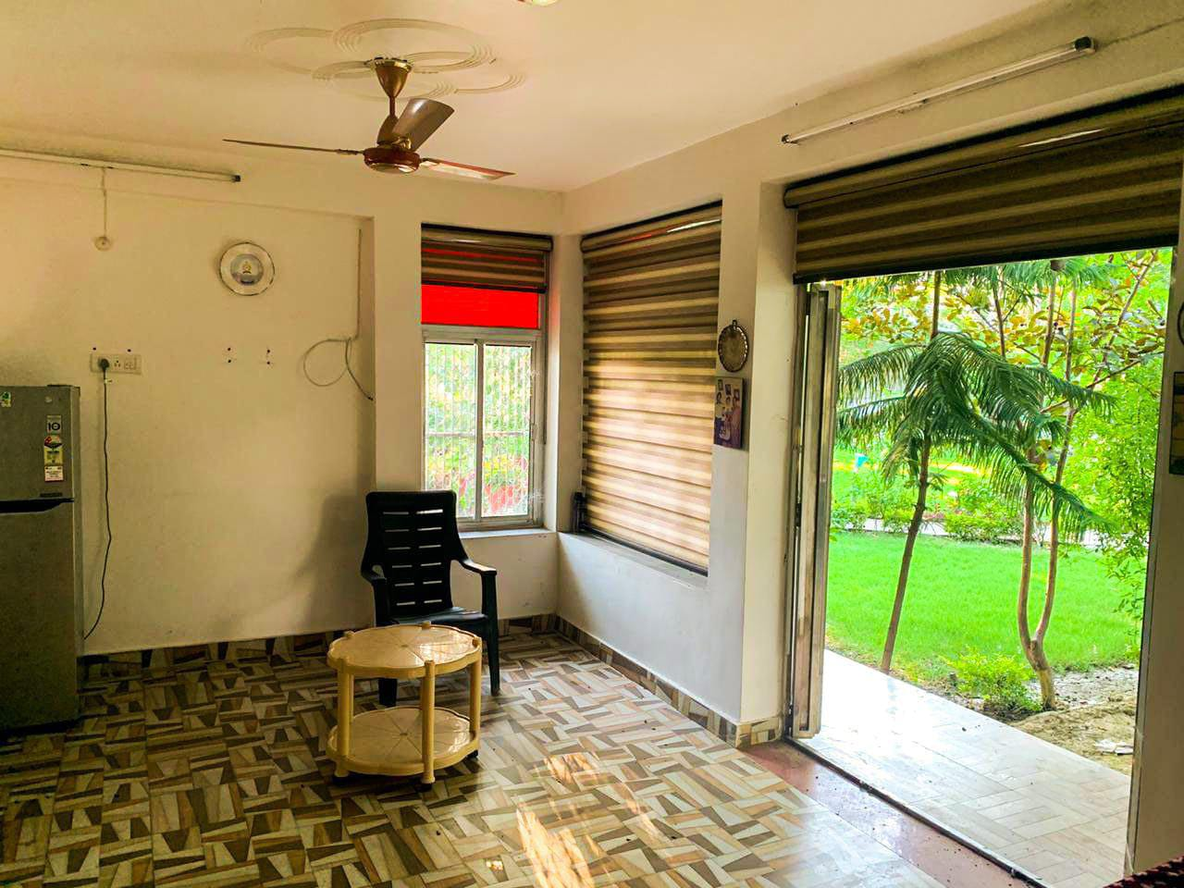
JMD GREEN PHASE – I
Lucknow Raebareli Road
FARM HOUSE

Slide 25
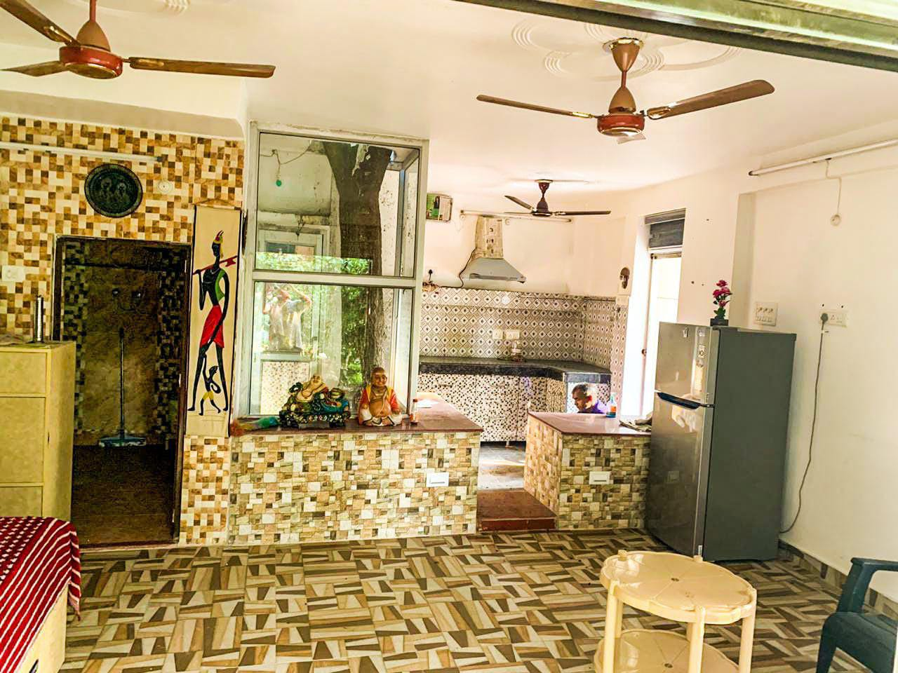
JMD GREEN PHASE – I
Lucknow Raebareli Road
FARM HOUSE

Slide 26
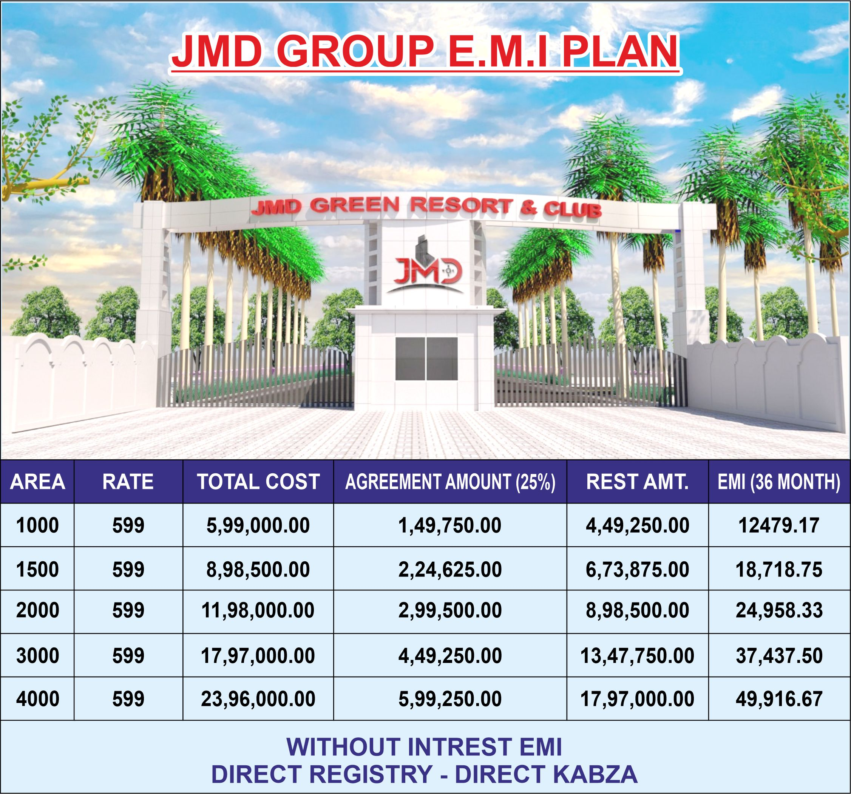
JMD GREEN PHASE – I
Lucknow Raebareli Road
EMI PLAN

Slide 27
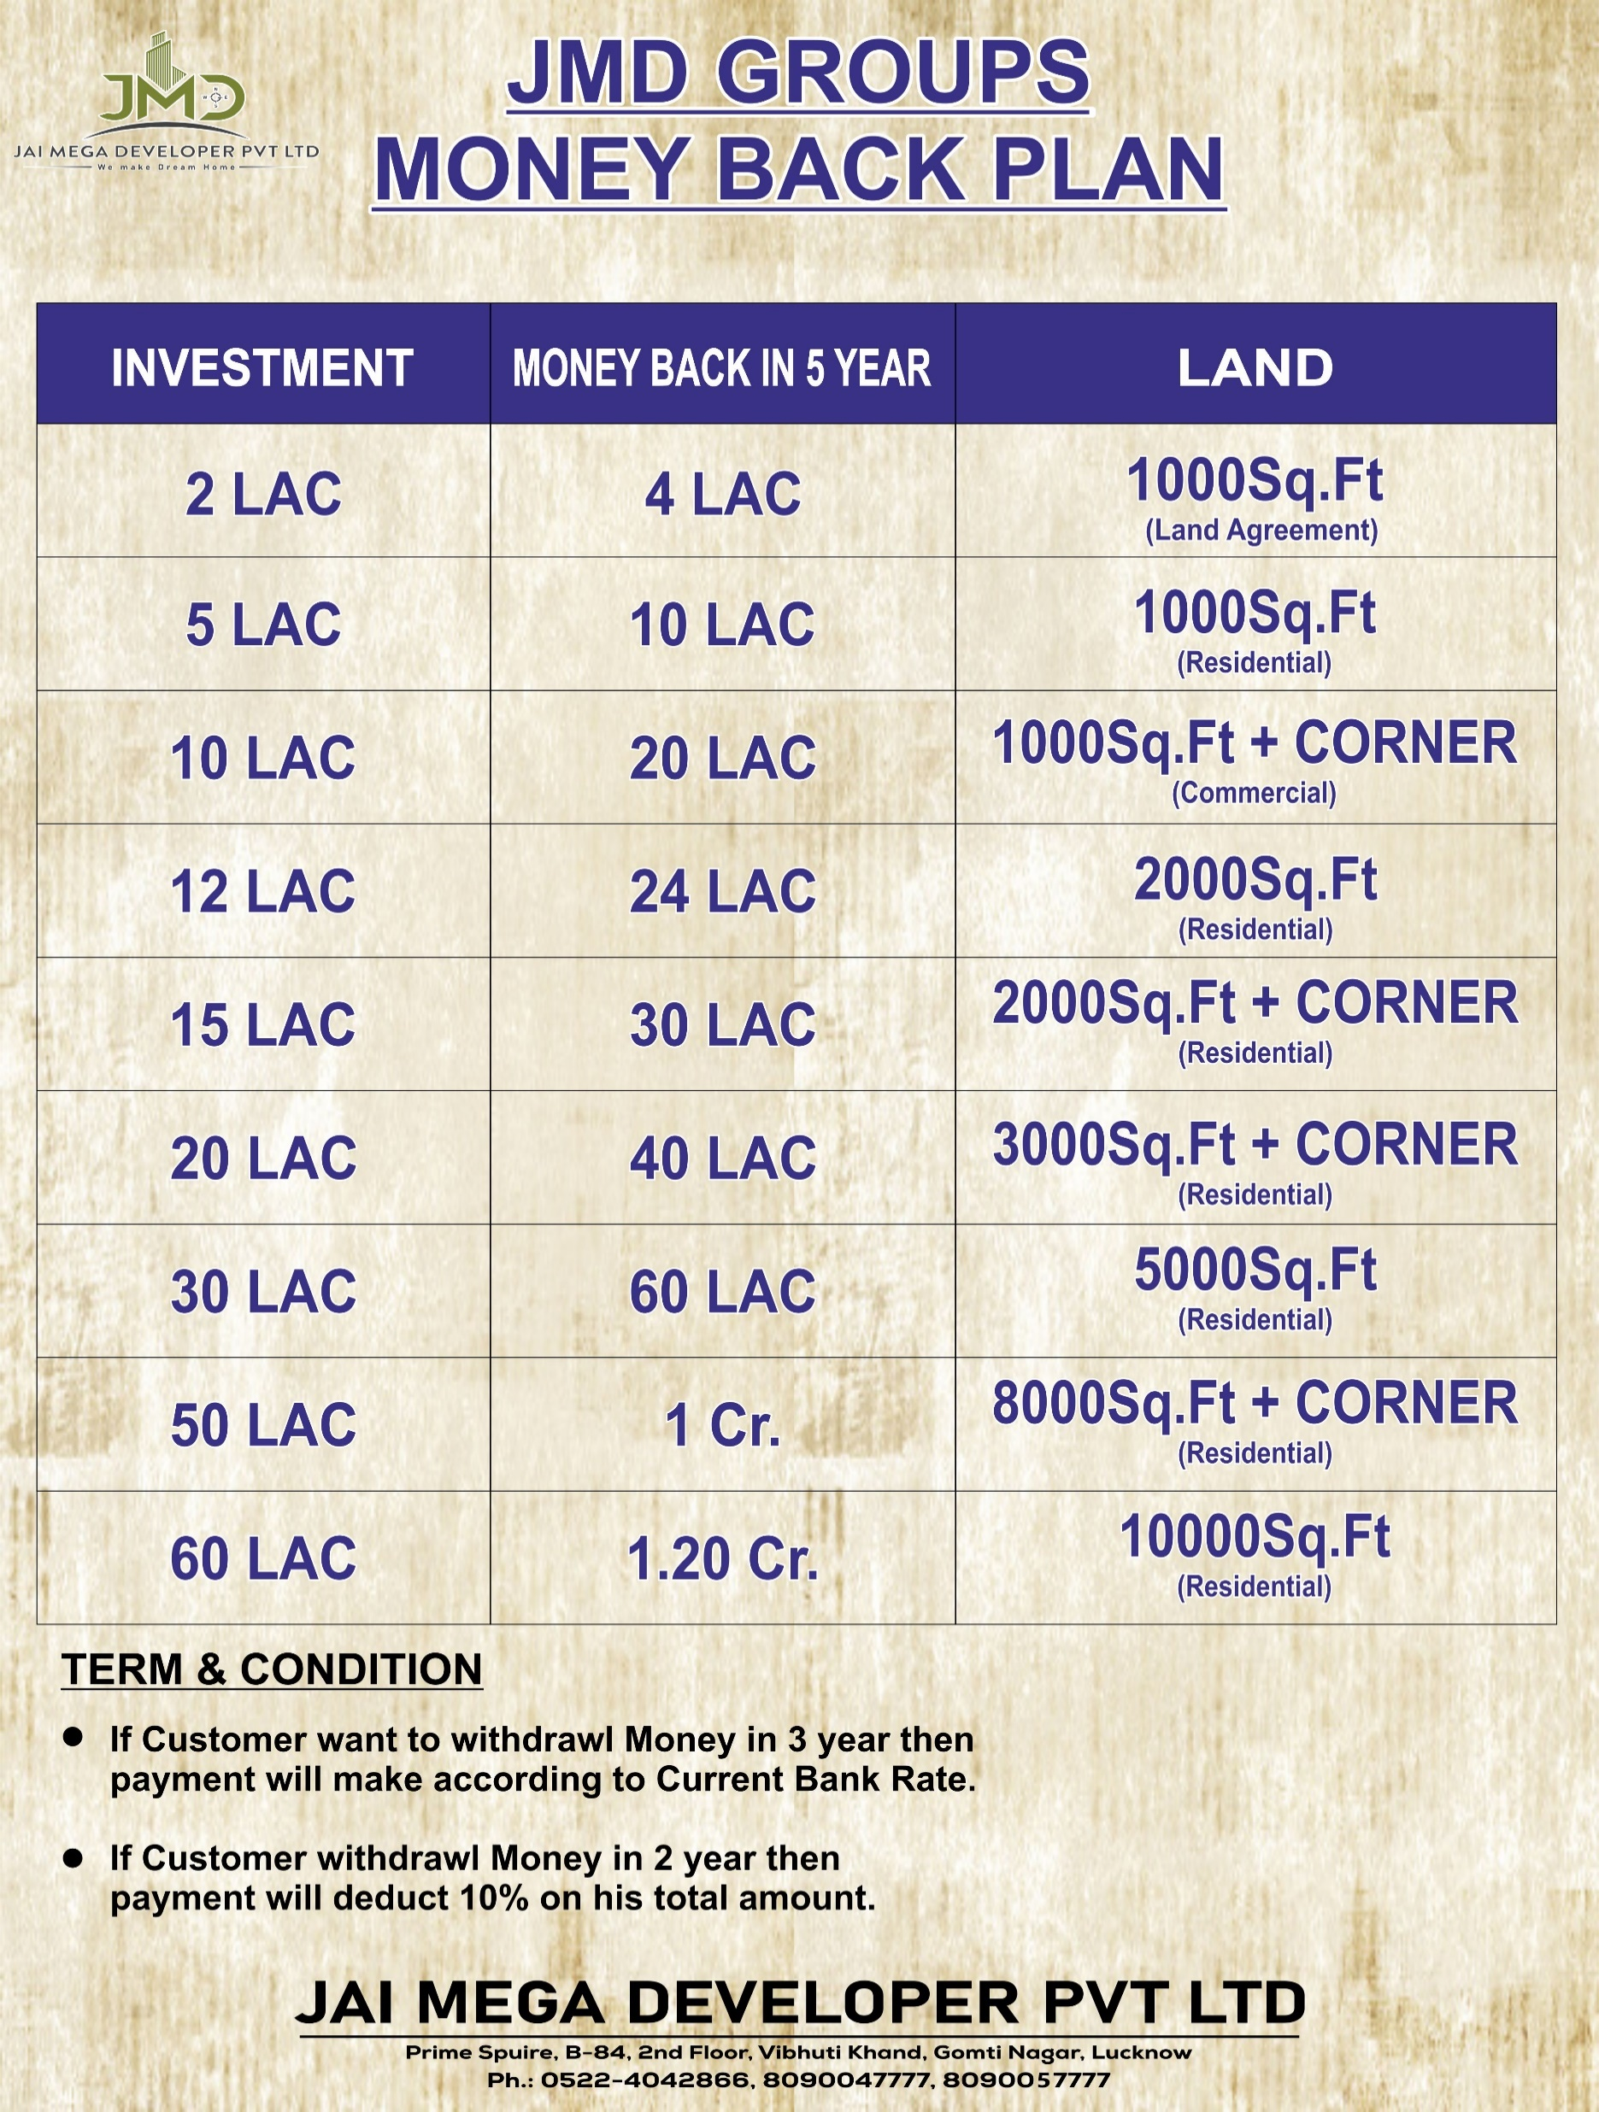
JMD GREEN PHASE – I
Lucknow Raebareli Road
MONEY BACK PLAN

Slide 28
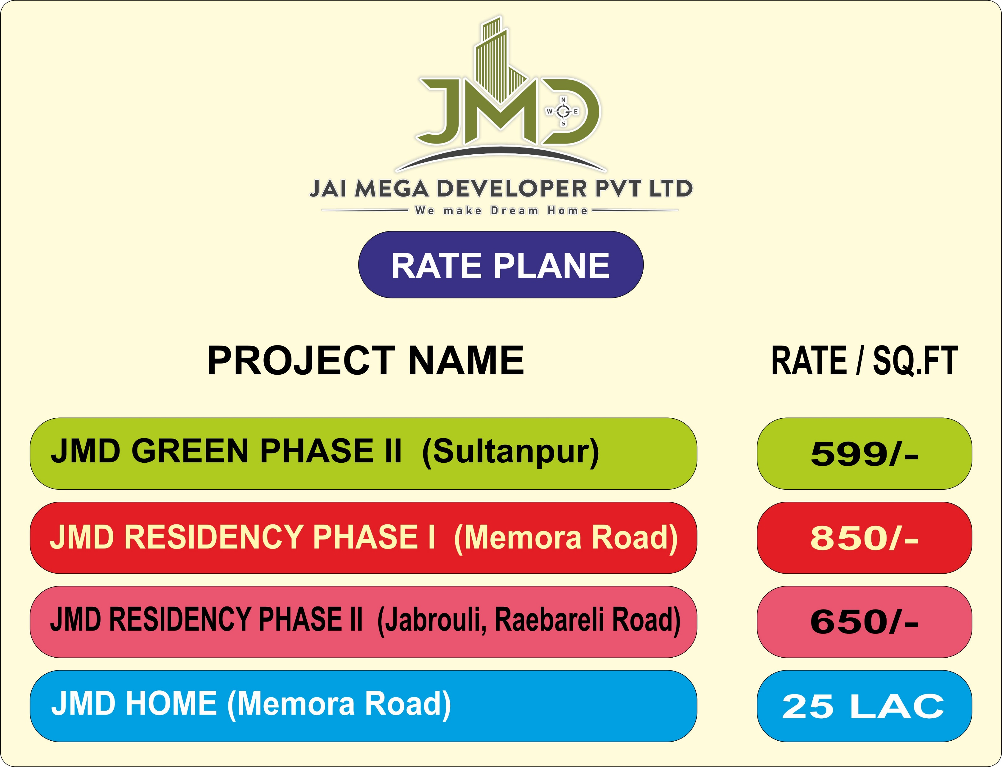
JMD GREEN PHASE – I
Lucknow Raebareli Road
OUR OTHER PROJECTS

Slide 29
JMD GREEN PHASE – I
Lucknow Raebareli Road
Why LUCKNOW ?
The City of Lucknow also know as City of Nawabs is ideally suited for investment in residential infrastructure because of the 4 C’s.
The Capital Phenomenon: Being the capital of Uttar Pradesh. Lucknow happens to be a big political centre and thus receives relatively extra favour for its all-round development, particularly related to infrastructure.
The Culture Phenomenon: The city, also known as ‘Tahzeebon ka Shahar’ is known for the calm and peaceful social environ that resides in this secular city.
Connectivity: The city is well connected to all major cities as well as small towns through good network of roads, rails and airways.
Centre of Growth: The city offers a wide range of earning and spending opportunities, in the form of jobs, services and also through world class quality education faciliites in all government as well as private institutions.

Slide 30
JMD GREEN PHASE – I
Lucknow Raebareli Road
Master Plan - 2031
Lucknow Development Authority (LDA) has announced to develop new city master plan taking into consideration facilities which the state capital would require till 2031. The current plant highlights the city planning till 2021. The new plan will cover Housing, Transportation Facility, Road Connectivity, Green Cover, Infrastructure, etc.
The Authority also decided to include the city’s extended area and construction of an Outer Ring Road of about 150 meter wide surrounding the city, under the master plan 2031. In the Master Plan, 176 NEW VILLAGES have come under the jurisdiction of development authority. After the inclusive of these village, Master Plan 2031 has 65,387.28 HECTARE LAND under its jurisdiction as against 43,206.03 hectare in the plan for 2021.

Slide 31
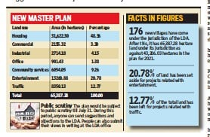
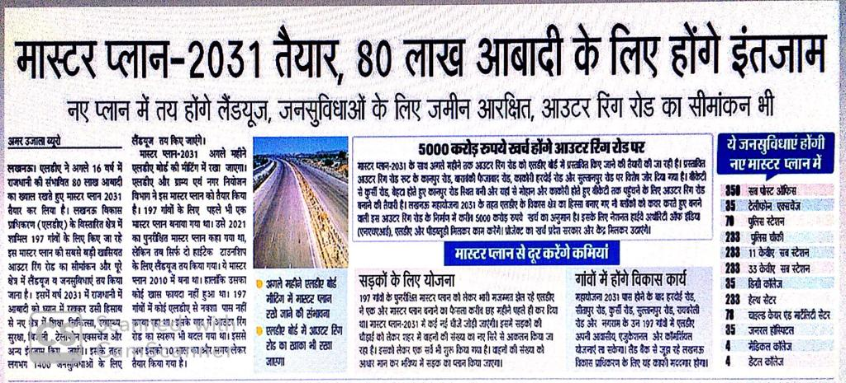
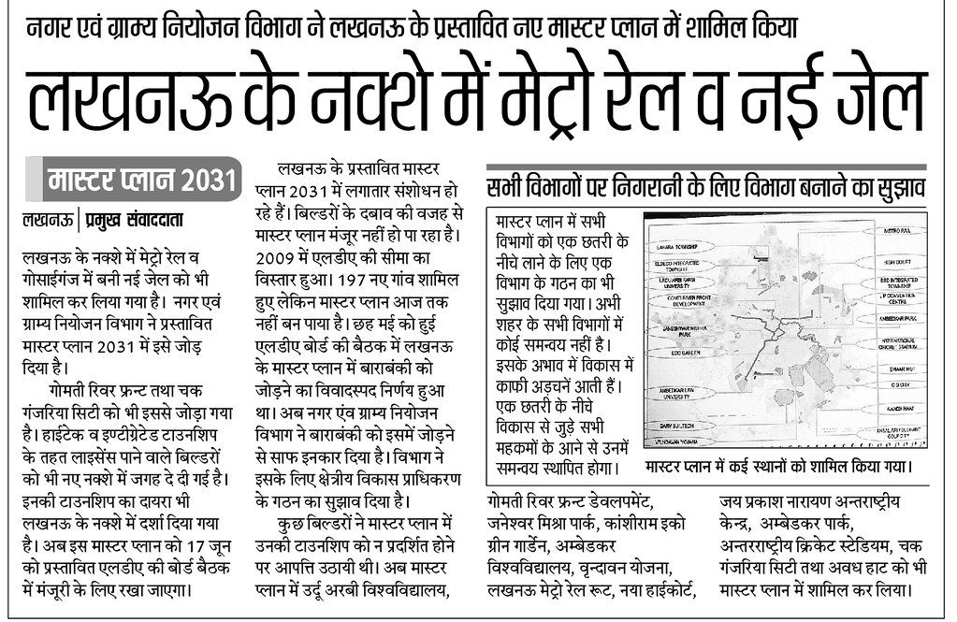
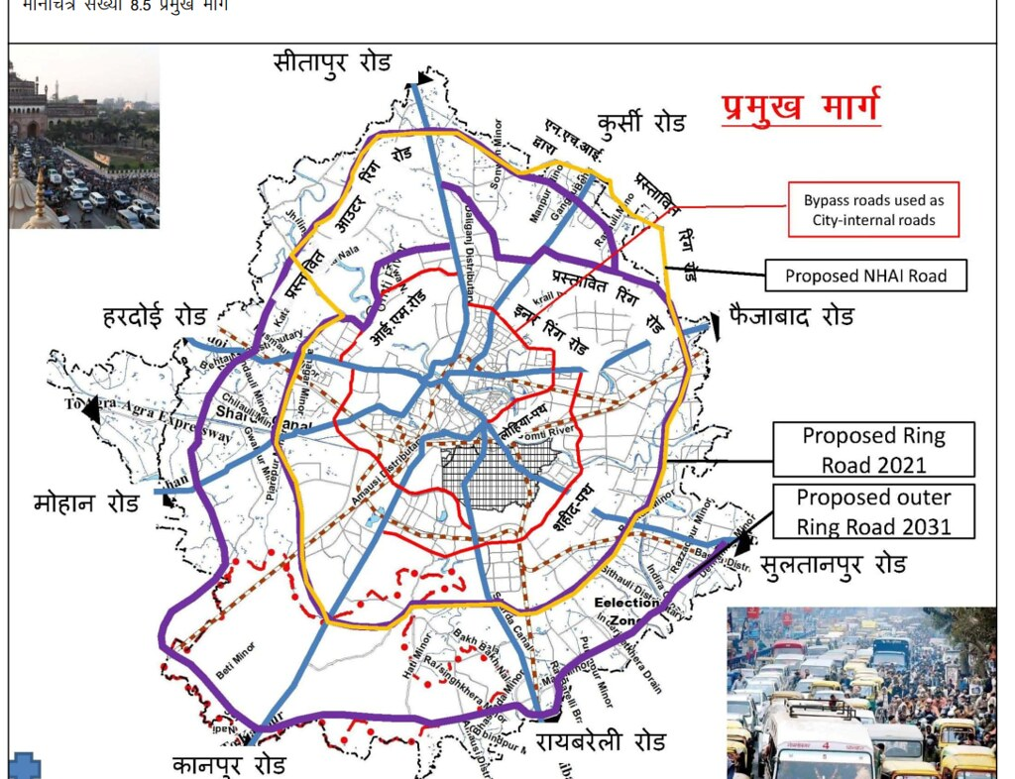
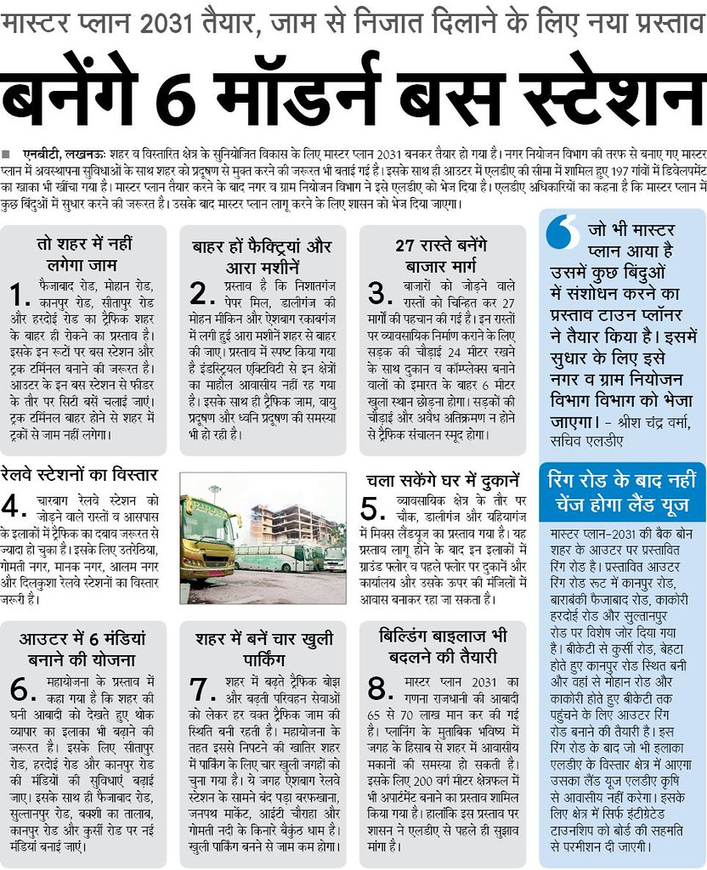
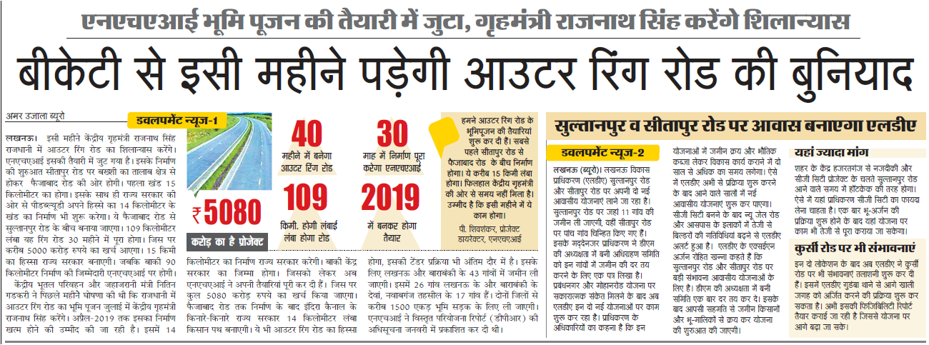
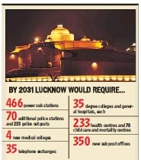
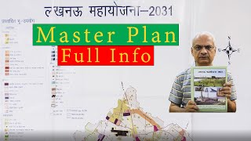
JMD GREEN PHASE – I
Lucknow Raebareli Road

Slide 32
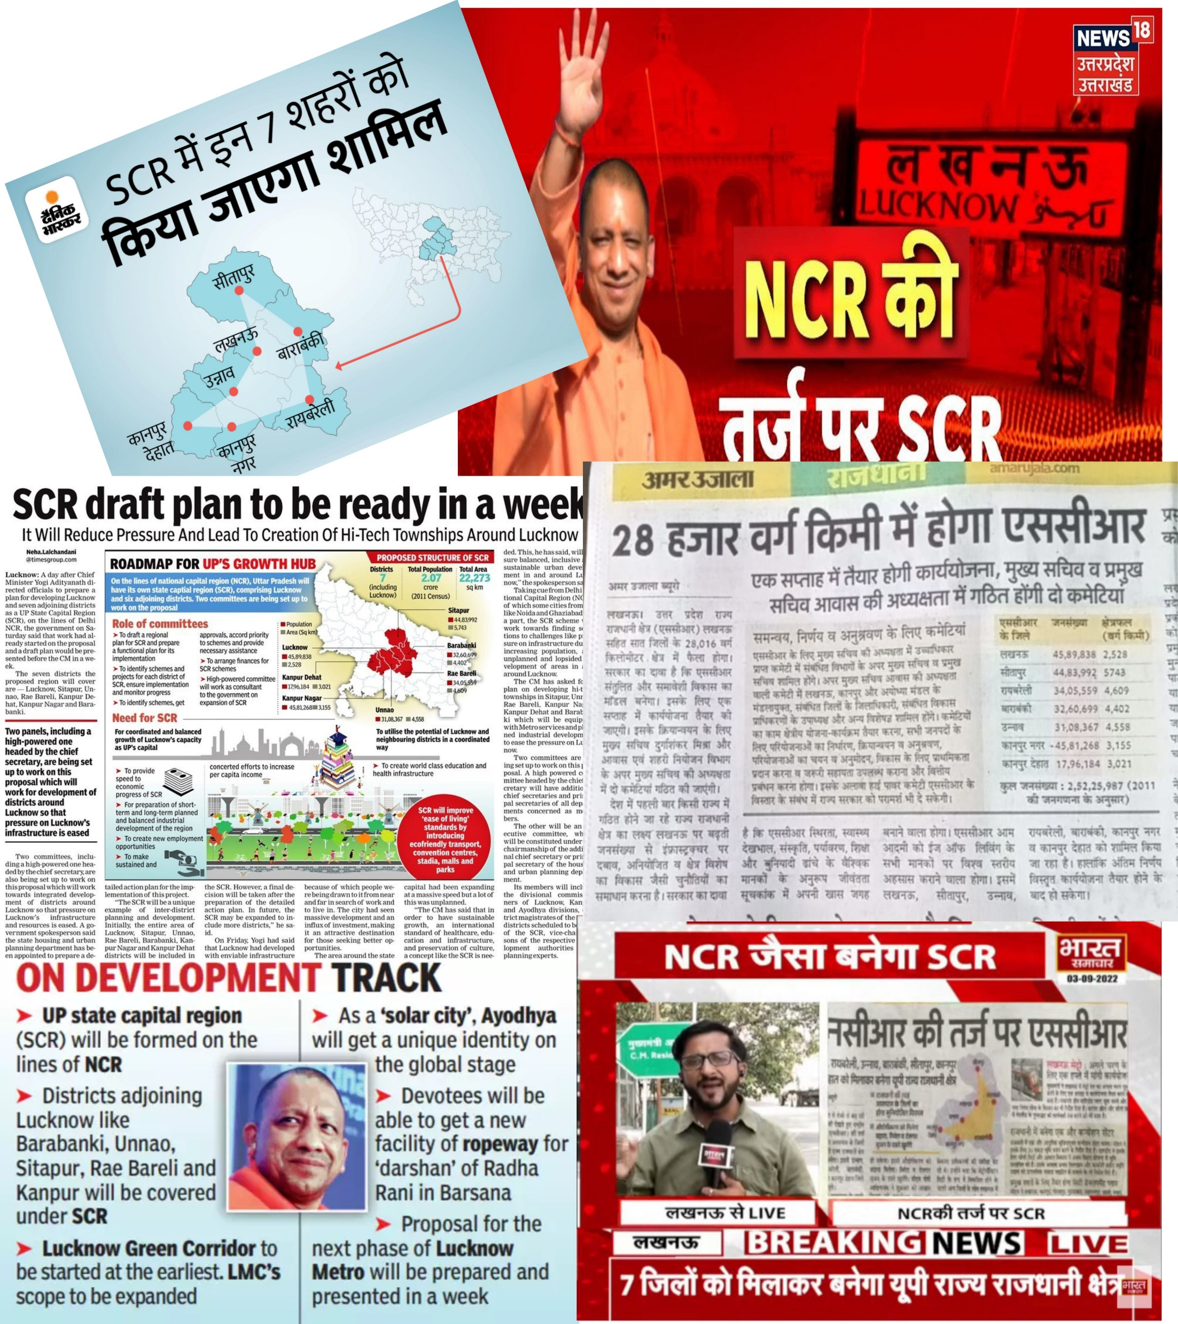
JMD GREEN PHASE – I
Lucknow Raebareli Road
NOW
LUCKNOW
SCR

Slide 33
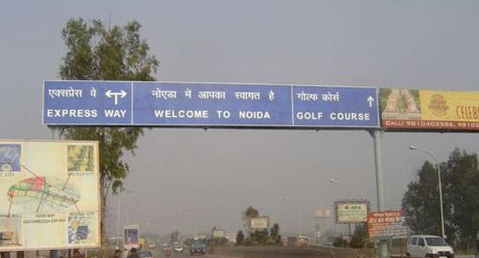
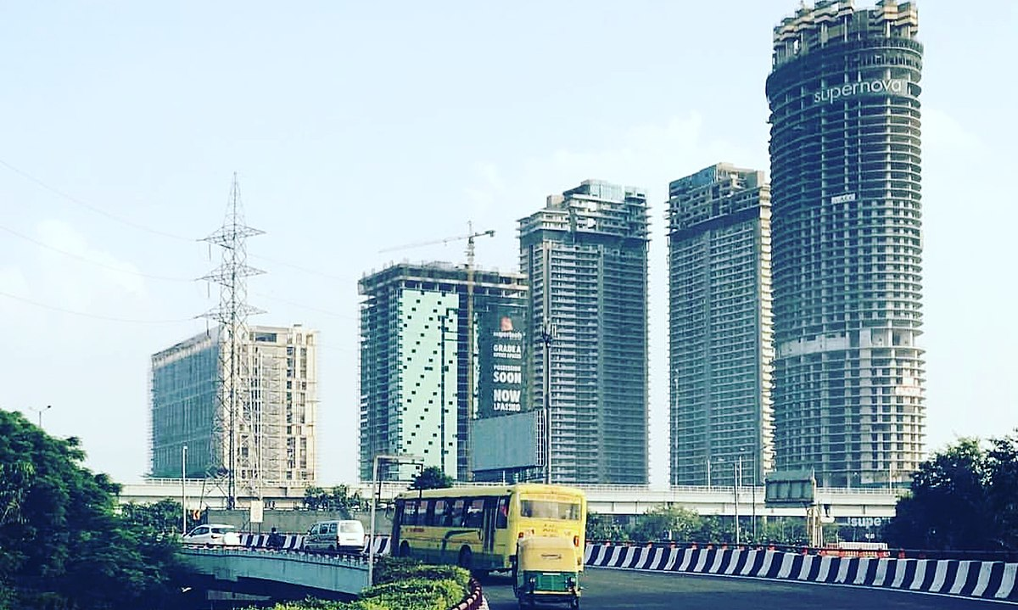
JMD GREEN PHASE – I
Lucknow Raebareli Road
OLD NOIDA
NEW NOIDA

Slide 34
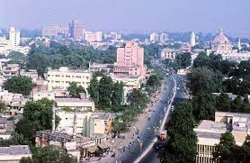
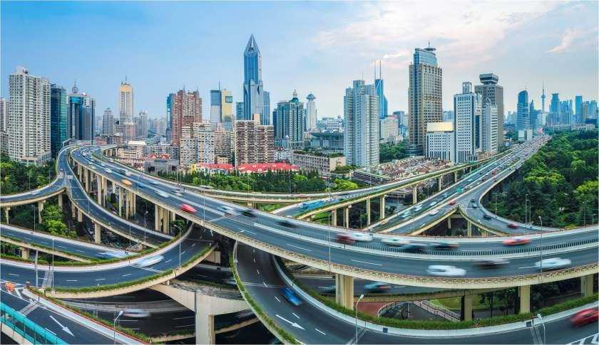
JMD GREEN PHASE – I
Lucknow Raebareli Road
CURRENT LUCKNOW
FUTURE LUCKNOW

Slide 35
JMD GREEN PHASE – I
Lucknow Raebareli Road
4 Basic Steps to Grow Business
LIST : Identify prospects and prepare a list of all the right customers for your business. Understanding Customer and their behavior is very important to keep up with your industry and stay ahead of competitors.
APPROACH : Connect with your prospects and schedule a time to explain them who you are and what your company is providing. Highlights the key factors of your product and its benefits.
FLOWUP : Call, Mail or personally visit to follow-up. A personalized follow-up always increase a chance of success. Resolve all queries of your customers.
CLOSE : Once you make a proper follow up and resolve all the queries of the customer its time to close the deal.

Slide 36
JAI MEGA DEVELOPER PVT. LTD.
H.O. Prime Square, B-84, Vibhuti Khand, Gomtinagar, Lucknow (U.P)-226010
Mob.: 8090047777, 8090057777

Slide 37


